Slide 1
FastWake: Revisiting Host Network Stack for Interrupt-mode RDMA
Bojie Li¹ Zihao Xiang¹ Xiaoliang Wang²
Han Ruan¹ Jingbin Zhou¹ Kun Tan¹
¹Huawei ²Nanjing University
Presenter: Bojie Li, Computer Network and Protocol Lab, Huawei

Slide 2
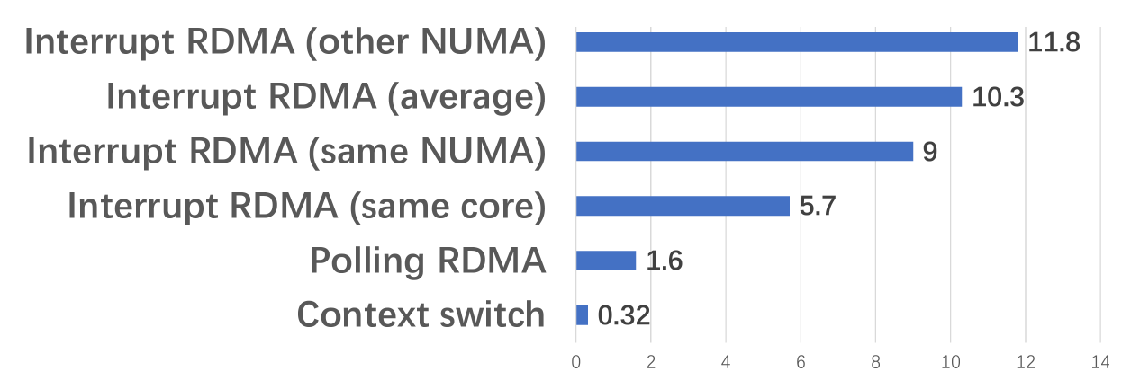

Interrupt-mode RDMA wastes the low latency of NICs

Slide 3
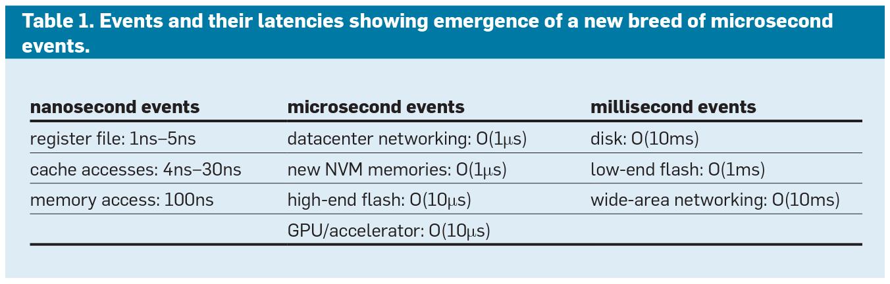
Emergence of Microsecond Events
LUIZ BARROSO, MIKE MARTY, DAVID PATTERSON, AND PARTHASARATHY RANGANATHAN, Attack of the Killer Microseconds, Communications of the ACM, 2017.

Slide 4
Why microsecond-scale latencies are hard to hide
CPU Instruction Pipeline
OS Process Scheduling
Nanosecond-scale latencies can be hidden by CPU out-of-order execution pipeline.
Example: DRAM access takes 50~100 ns, where the CPU core can execute independent instructions after the DRAM access.
CPU out-of-order pipeline only supports hundreds of instructions, so microsecond-scale latencies would stall the pipeline and decrease the efficiency of CPU.
OS process scheduling is designed to hide millisecond-scale latencies.
Context switching to another process takes 3~5us.
RDMA Read takes only 2~3us.
If we context switch to another process after sending the RDMA Read request, and switch back after receiving the RDMA response, then the CPU is wasted on process scheduling.
Traditional TCP
RDMA
Task 1
Task 2
Task 3
Task 1
Task 2
Task 3
context switch
RDMA Read
a = *p; // memory access
b = c + d;
e = b + c;
d = b + d;
c = b + c;
f = b + a; // stall for memory access
context switch
TCP send
RDMA Read response
Out-of-order execution
TCP recv
context switch
context switch

Slide 5
Why interrupt-mode RDMA has high latency?
RDMA NIC
①
CQ1
③
EQ
②
interrupt
⑨
App Thread
CQ: Completion Queue.
  Each CQ has a completion vector, which determines the CPU cores to deliver interrupts
EQ: Event Queue for interrupt notification.
  A completion vector corresponds to an EQ in kernel-mode host memory.
  EQ entries contain CQ numbers to notify.
①②③ NIC: 1.5 us
④⑤⑦ kernel (same core): 2.2 us
④⑤⑥⑦ kernel (different cores): 6.9 us
⑧ context switch: 0.3 us
Kernel
Interrupt handler
Inter-Processor Interrupt
④
⑥
⑦
⑤
Scheduler
Tasklet
⑧
Context switch

Slide 6
Key Observation 1
Direct context switch is much faster than process scheduling.
  Mutex and semaphore are IPC primitives provided by the kernel that achieves context switch by process scheduling.
Context switch
Mutex/Semaphore
Thread 1
Thread 2
Thread 1
Thread 2
while (true) {
sched_yield();
}
while (true) {
sched_yield();
}
while (true) {
lock(&g_mutex);
unlock(&g_mutex);
}
while (true) {
lock(&g_mutex);
unlock(&g_mutex);
}
Kernel (context switch)
Kernel (thread scheduling)

Slide 7
Approach 1: per-core dispatcher thread
RDMA NIC
The CQ is mapped to both application thread and a per-core dispatcher thread.
NIC sends CQE to the CQ.
Dispatcher thread polls all CQs on the core and peeks CQE from the CQ, but do not pop it out of CQ.
Dispatcher thread context switches to the application thread directly.
The application thread pops the CQE out of CQ.
When the application waits on the next event, it context switches back to the dispatcher thread.
①
CQ1
CQ2
Peek CQE
Peek CQE
Dispatcher Thread
②
App Thread 1
③
App Thread 2
④
⑤
Kernel context switch

Slide 8
How to implement direct context switch?
Linux does not support context switching to a specific thread.
We introduce a new system call switch_to(pid)
  Simply checks the permission and puts the thread pid to the head of runqueue.
  Performance: 0.3~0.4 us.
Security:
  To avoid switch_to(pid) being abused to starve other threads, we only allow non-dispatcher threads to switch to dispatcher threads and only allow dispatcher threads to switch to non-dispatcher threads.
    We introduce a flag bit in the process control block to indicate whether it is a dispatcher thread.
Limitations:
  Direct context switch makes application threads have high priority than other threads with the same priority. However, because each priority has its own runqueue, threads with higher priority still takes precedence.

Slide 9
Key Observation 2
Interrupt delivery to a thread running on the same core is much faster than other cores.
Reason: inter-processor interrupts (IPI) to wake up another core.

Slide 10
Approach 2: interrupt core affinity & shorten kernel path
How to make sure interrupts and the thread are on the same core?
Wake up threads
Core 1
ISR
MSIX interrupt
Thread 1
CQ1
create_cq(..., comp_vector=1)
EQ1
Completion vectors
Thread 2
CQ2
EQEs including CQ numbers
Core 1
create_cq(..., comp_vector=1)
RDMA
NIC
Core 2
Thread 3
CQ3
EQEs including CQ numbers
create_cq(..., comp_vector=2)
EQ2
Thread 4
CQ4
Core 2
ISR
Wake up threads
create_cq(..., comp_vector=2)

Slide 11
Approach 2: interrupt core affinity & shorten kernel path
What if the creator of the CQ and the user of the CQ are in different threads and on different cores?
What if a thread migrates to another core?
We need to dynamically update the affinity between CQs and EQs.
We leverage a feature in Mellanox NICs: CQ-to-EQ remapping.
The remapping is done lazily when the interrupt handler finds the thread to wake up is not on the same core.

Slide 12
Approach 2: interrupt core affinity & shorten kernel path
Do CQ-to-EQ remapping when interrupt and thread are on different cores.
Core 1
ISR
MSIX interrupt
Thread 1
CQ1
EQ1
Completion vectors
create_cq(..., comp_vector=1)
EQEs including CQ numbers
Core 1
Inter-processor interrupt (IPI)
RDMA
NIC
Thread migration
Core 2
Thread 1’
CQ1
EQEs including CQ numbers
modify_cq(..., comp_vector=2)
EQ2
Core 2
ISR
Wake up thread

Slide 13
Approach 2: interrupt core affinity & shorten kernel path
RDMA NIC
①
RDMA NIC
CQ1
EQ
①
③
②
interrupt
CQ1
③
EQ
②
⑨
interrupt
App Thread
Kernel
⑥
Interrupt handler
Inter-Processor Interrupt
App Thread
④
⑥
⑦
⑤
Scheduler
Tasklet
Kernel
⑧
Context switch
④
Interrupt handler
Compared to traditional interrupt delivery path:
Remove tasklet and handle interrupts in top half.
  Top-half cannot use locks and dynamically allocated memory that may lead to sleep, so we remove them.
Directly put the thread to wake up at the head of the runqueue, bypassing the kernel scheduler.
Other minor optimizations (see the paper).
Context switch
⑤

Slide 14
FastWake system architecture
Application
FastWake daemon
Compatible with existing RDMA applications.
  Only need an LD_PRELOAD library as a shim layer.
Compatible with existing OS.
  Update OFED kernel modules to shorten thread wake-up path and implement CQ-to-EQ remapping.
  Add a switch_to(pid) system call for direct context switch.
Compatible with existing RDMA NIC hardware.
FastWake shim layer
Per-core
polling threads
libibverbs
Kernel
ib_uverbs/core
switch_to() syscall
CQ-EQ remap
Comp channel
RDMA NIC

Slide 15
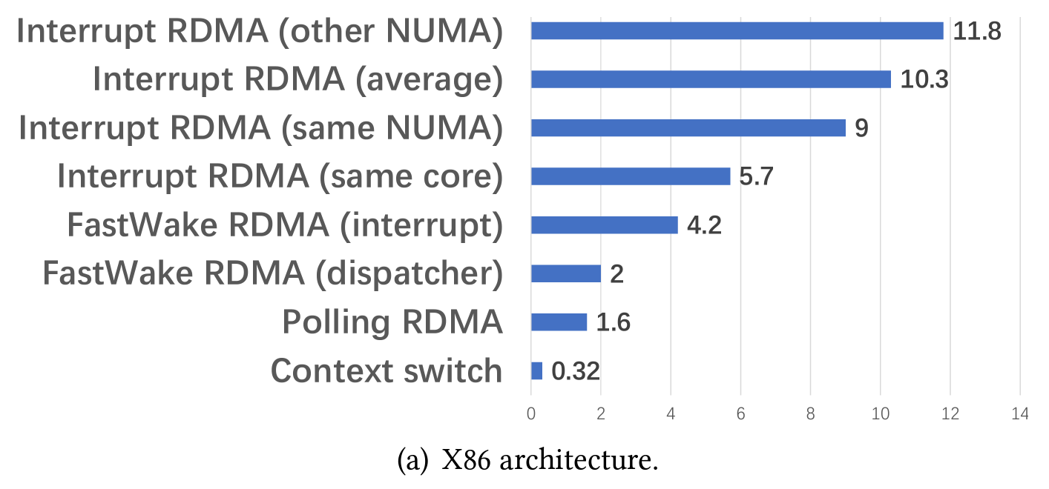
Evaluation – Latency (x86)
Dispatcher approach: reduce RDMA latency by 65%~83% on x86 at the cost of high power utilization.
Interrupt approach: reduce RDMA latency by 26%~64% on x86.

Slide 16
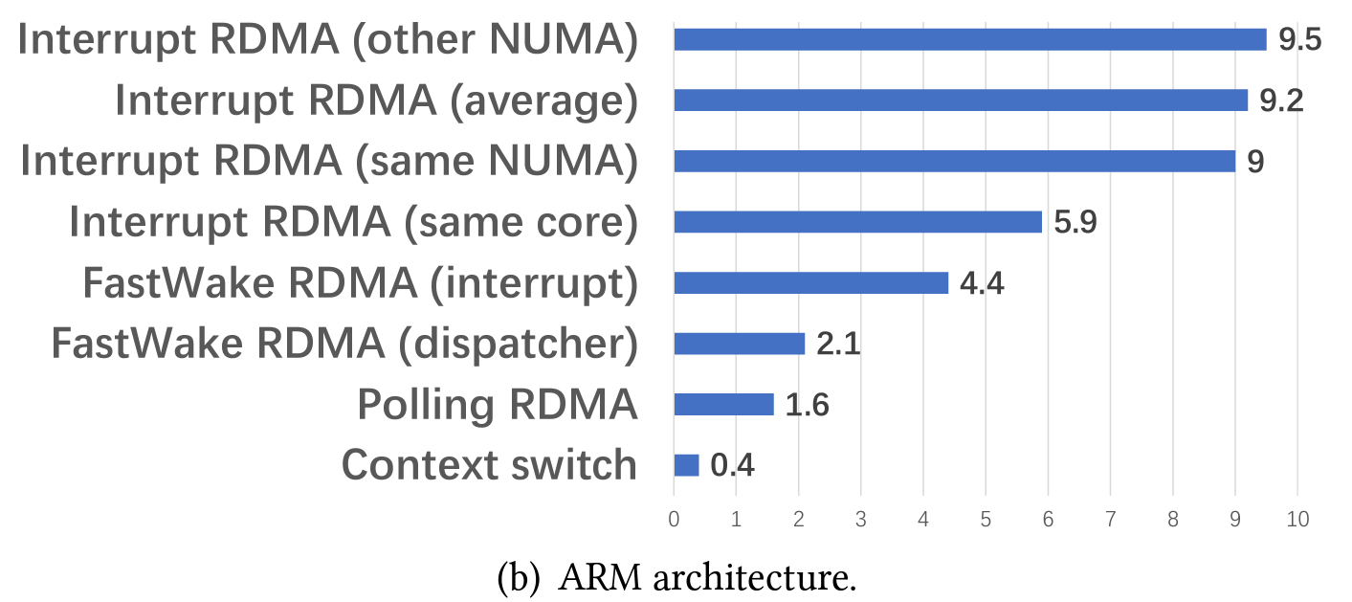
Evaluation – Latency (ARM)
Dispatcher approach: reduce RDMA latency by 64%~78% on ARM at the cost of high power utilization.
Interrupt approach: reduce RDMA latency by 25%~54% on ARM.

Slide 17
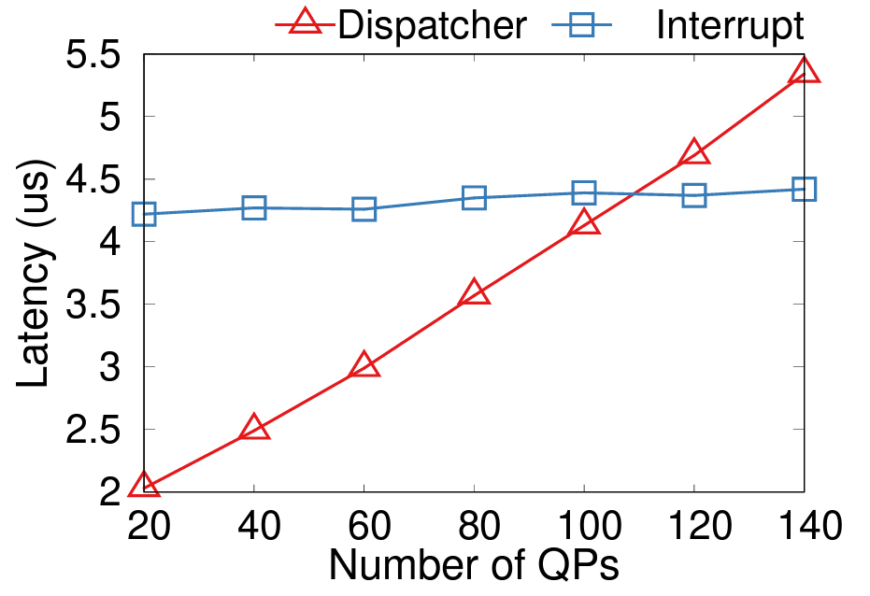
Comparing dispatcher and interrupt approaches of FastWake

Slide 18
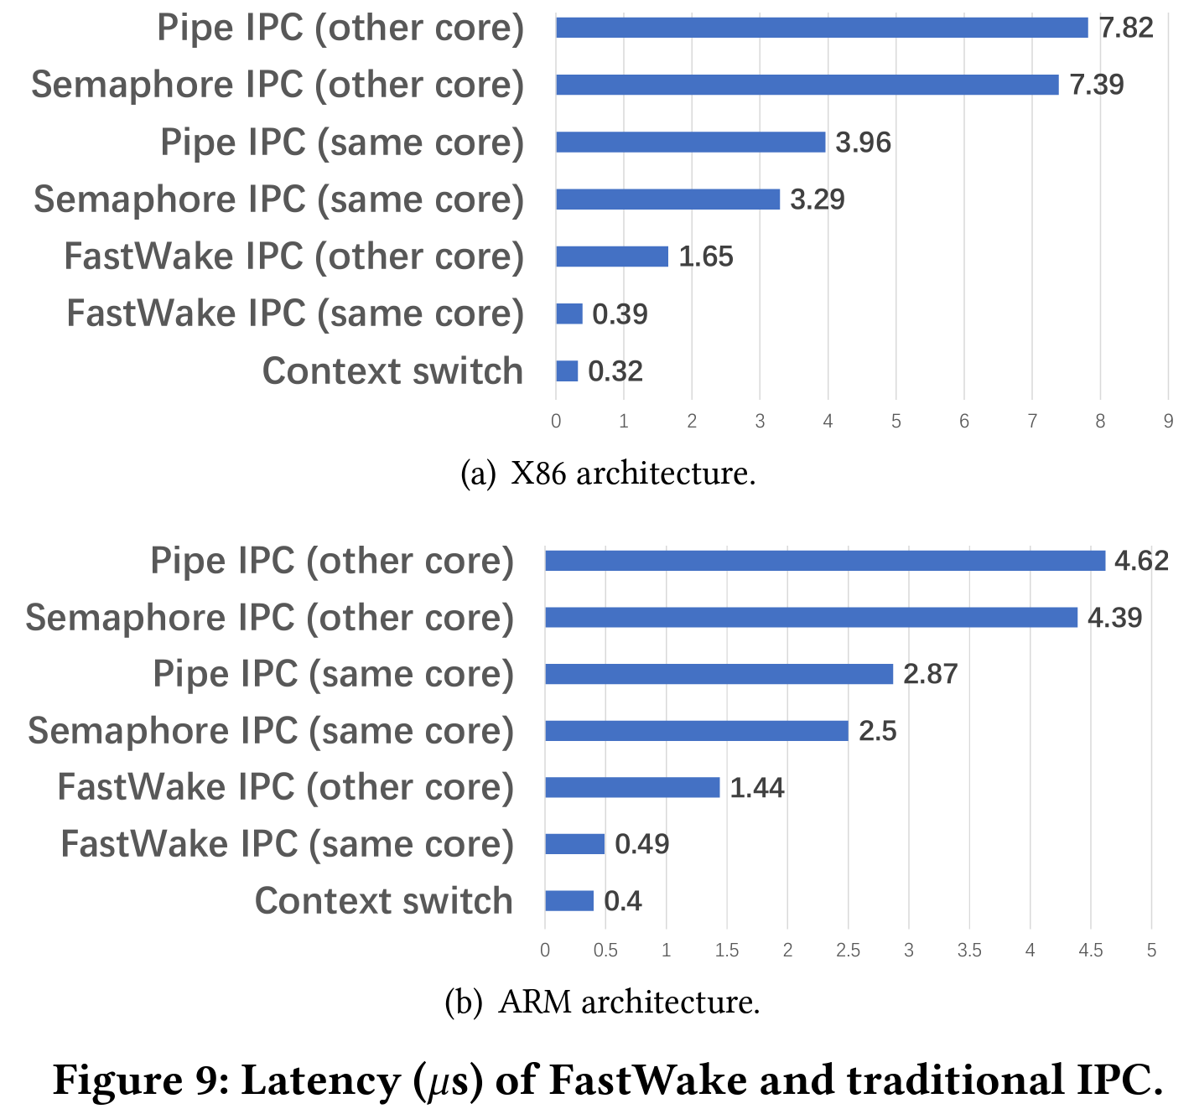
FastWake can also reduce IPC latency
IPC = Inter-Process Communication

Slide 19
Conclusion
Data center networking and storage hardware are entering an age of microsecond-scale latency.
  Current CPU hardware and OS cannot hide this latency.
FastWake proposes two approaches with commodity NIC, OS and applications:
  Observation 1 – context switch is much faster than process scheduling.
    Solution 1 – build a per-core dispatcher thread and fast context switch to fully remove the interrupt overheads.
      Reduce RDMA latency by 65%~83% on x86 and 64%~78% on ARM.
      Only 0.4us (20%) higher than polling mode.
  Observation 2 – interrupt core affinity is crucial for performance.
    Solution 2 – a power-saving approach to reduce interrupt latency by ensuring interrupt core affinity and shortening kernel path.
      Reduce RDMA latency by 26%~64% on x86 and 25%~54% on ARM.
We expect future work to evaluate FastWake on real applications.
“The Killer Microseconds” is still an open problem.

Slide 20
Thanks!
Q&A
Welcome to join/collaborate with Computer and Network Protocol Lab, Huawei.

