Slide 1
Implementing ClickNP: Highly Flexible and High Performance Network Processing on CPU + FPGA
Bojie Li^{1,2}, Kun Tan¹, Layong (Larry) Luo¹, Yanqing Peng^{1,3}, Renqian Luo^{1,2}, Ningyi Xu¹, Yongqiang Xiong¹, Peng Cheng¹, Enhong Chen²
¹Microsoft Research, ²USTC, ³SJTU
Notes:
Thanks Francis for the introduction.
Hello everyone.
I’m Bojie Li, a third-year Ph.D. student.
My topic today is implementing ClickNP, highly flexible and high performance network processing on CPU and FPGA.
I did this work with my mentor Dr. Kun Tan and other collaborators during an internship with Microsoft Research Asia.

Slide 2
Outline
What is ClickNP?
Highly flexible and high performance network processing platform on CPU + FPGA (Programmable NIC)
Published on SIGCOMM’16
How ClickNP was built?
8 months since my mentor Dr. Kun Tan built the first prototype
100 elements, 5 network functions
1K commits, 20K lines of code
Where ClickNP will go?
General-purpose FPGA programming in research team
2 years, 10+ users
300 elements, 86 application projects, 80K lines of code
Notes:
My talk will have three parts.
First, for the audience not familiar with ClickNP, I will take 5 minutes to briefly introduce the system.
Second, how ClickNP was built. This is the main part of my talk.
Finally, ClickNP is not only a paper work, but also a solid system to inspire future research.

Slide 3









Virtualized network functions
Dedicated hardware NFs are not flexible
Virtualized NFs on servers to maximize flexibility
Load
Balancer
NAT
Firewall
IPSec
Gateway
Load
Balancer
VMs
Firewall
VMs
NAT
VMs
IPSec
Gateway
VMs
Notes:
First we will introduce ClickNP.
Multi-tenant datacenters requires flexible network functions to ensure security and performance isolation.
Dedicated hardware network function are not flexible enough to support multi-tenancy and respond to changing requirements.
Therefore, almost all cloud providers have been deploying virtualized network functions on servers to maximize flexibility.

Slide 4
Scale-up challenges for software NF
Limited processing capacity
  Number of CPU cores needed for 40 Gbps line rate
Network function | Implementation | 1500B pkt @ 40 Gbps (normal case) | 64B pkt @ 40 Gbps (worst-case estimate)
NVGRE tunnel encapsulation | Hyper-V virtual switch | 5 | 100
Firewall (8K rules) | Linux iptables | 21 | 480
Notes:
There are two major challenges for software network functions.
First, software network functions have limited processing capacity.
For example, for NVGRE tunnel encapsulation, the virtual switch requires 5 CPU cores to sustain 40 gigabit line rate.
In the worst case, when all the packets are tiny, it requires as many as 100 cores to sustain line rate.

Slide 5
Scale-up challenges for software NF
Limited processing capacity
  Number of CPU cores needed for 40 Gbps line rate
Inflated and unstable latency
  Add tens of microseconds to milliseconds latency to data plane
  Latency may grow to milliseconds under high load
  1 ms occasional delay would violate SLA (e.g., trading services)
Network function | Implementation | 1500B pkt @ 40 Gbps (normal case) | 64B pkt @ 40 Gbps (worst-case estimate)
NVGRE tunnel encapsulation | Hyper-V virtual switch | 5 | 100
Firewall (8K rules) | Linux iptables | 21 | 480
Notes:
Second, software network functions have inflated and unstable latency.
A software-based network function adds tens of microseconds to milliseconds latency to the data plane.
When the load is high, this latency may grow to several milliseconds.
However, an occasional delay of one millisecond would already violate the service level agreement for delay sensitive applications.

Slide 6
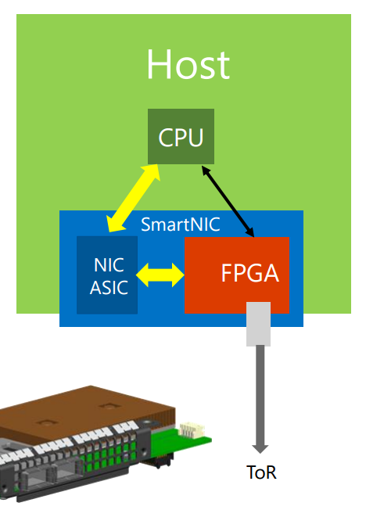
FPGA in the cloud
FPGA-based SmartNIC
  Bump-in-the-wire processing between
  NIC and ToR switch^{[1]}
[1] SIGCOMM’15 keynote (also the image source)
Notes:
To accelerate network functions in servers, we have deployed FPGA-based SmartNICs at scale in Microsoft datacenters.
The FPGA performs bump-in-the-wire processing between commodity NIC and top-of-rack switch.

Slide 7
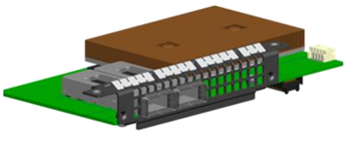
FPGA in the cloud
FPGA-based SmartNIC
  Bump-in-the-wire processing between
  NIC and ToR switch^{[1]}
Why FPGA?
  Massive parallelism
  - Millions of logic elements Thousands of “cores” in parallel
  - Thousands of memory blocks TB/s memory bandwidth
  Low power consumption (~20W)
  General computing platform (vs. GPU, NP)
  to accelerate various cloud services
  Mature technology with a reasonable price
[1] SIGCOMM’15 keynote (also the image source)
Notes:
There are several reasons for choosing FPGA as the accelerator.
First, FPGA has massive parallelism.
It has millions of logic elements, which can build thousands of “cores” running in parallel.
FPGA also has thousands of memory blocks, which can produce terabytes per second aggregated memory bandwidth.
Second, FPGA has low power consumption.
Third, FPGA is a general computing platform to accelerate various cloud services.
Finally, FPGA is a mature technology with reasonable price in recent years.

Slide 8
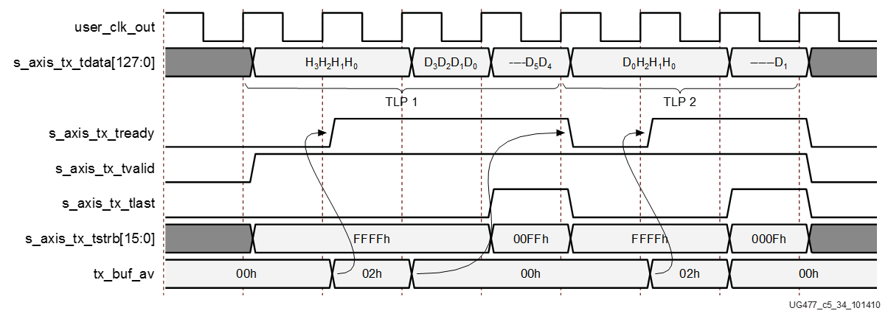

FPGA challenge: Programmability
Hardware description language (HDL): push many software developers away
PCIe Core
DMA Engine
always @ (posedge SYSCLK or negedge RST_B)
begin
if(!RST_B)
DMA_TX_DATA <= `UD 8'hff;
else
DMA_TX_DATA <= `UD DMA_TX_DATA_N;
end
//send: "hello world !"
always @ (posedge SYSCLK)
begin
if (rst) begin
dma_data <= 88’h0;
dma_valid <= 1’b0;
else
if (dma_start) begin
dma_data <= 88’h68656C6C6F20776F726C64;
dma_valid <= 1’b1;
end
else begin
dma_data <= 88’h0;
dma_valid <= 1’b0;
end
end
end
Ahhhhhhhhhhhh!
Notes:
The main challenge to use FPGA is programmability.
Conventionally, FPGA is programmed with low-level hardware description languages, such as Verilog and VHDL.
The difficulty of hardware description languages have pushed many software developers away for years.

Slide 9
Project ClickNP
Making FPGA accessible to software developers
Flexibility: fully programmable using high-level language
Notes:
In this work, we present ClickNP, a platform to make FPGA accessible to software developers.
We have several design goals.
First, the platform should be fully programmable using high-level languages.

Slide 10
Project ClickNP
Making FPGA accessible to software developers
Flexibility: fully programmable using high-level language
Modularized: Click abstractions familiar to software developers; easy code reuse
Notes:
Second, the platform should have a modular architecture familiar to software developers. In particular, we choose abstractions similar to the Click modular router for easy code reuse.

Slide 11
Project ClickNP
Making FPGA accessible to software developers
Flexibility: fully programmable using high-level language
Modularized: Click abstractions familiar to software developers; easy code reuse
High performance: high throughput; microsecond-scale latency
Notes:
Third, the platform should provide high performance, both in terms of throughput and latency.

Slide 12
Project ClickNP
Making FPGA accessible to software developers
Flexibility: fully programmable using high-level language
Modularized: Click abstractions familiar to software developers; easy code reuse
High performance: high throughput; microsecond-scale latency
Joint CPU/FPGA packet processing: FPGA is no panacea; fine-grained processing separation
Notes:
Finally, the platform should support joint CPU and FPGA packet processing.
That’s because FPGA is not suitable for every kind of workload.
We should support fine-grained processing separation between CPU and FPGA.

Slide 13
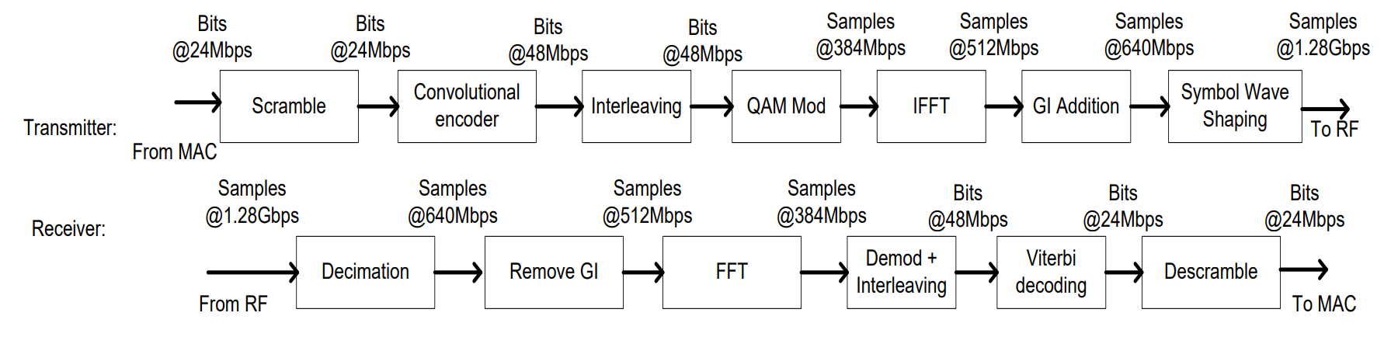
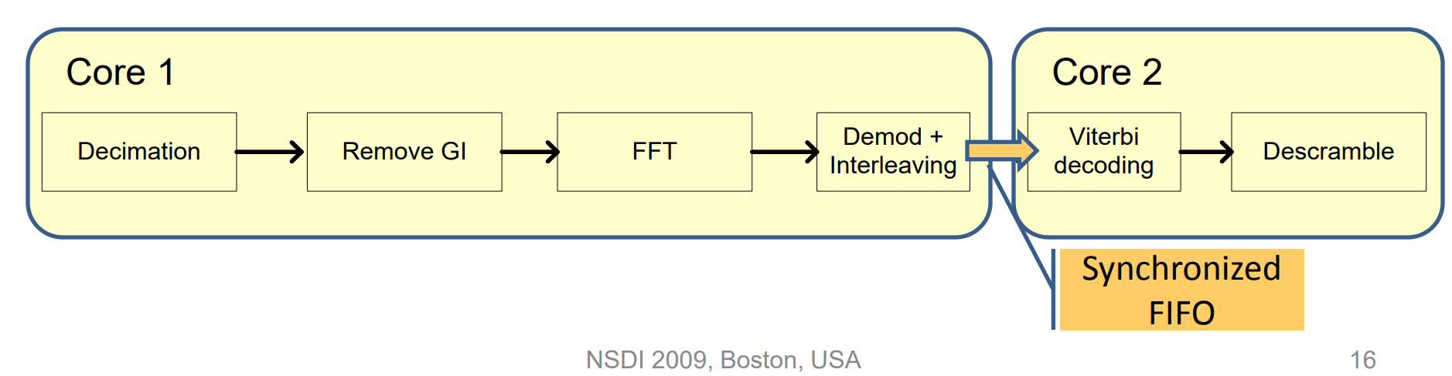
Analogy: Sora (NSDI’09)
Modular Software-defined Radio
Pipelined dedicated cores for performance
Notes:
The design goals of ClickNP are very similar to a previous work of our research group, Sora.
Sora is a modular software-defined radio platform and won the best paper award on NSDI 2009.
The requirements of flexible, modular and high performance are the same between Sora and ClickNP.
ClickNP replaces radio processing with network processing, and uses programmable hardware instead of pure CPU design.

Slide 14
ClickNP programming model
as if programming on a multi-core processor
cores (elements) running in parallel
A
B
C
mem
mem
mem
Notes:
ClickNP provides a modular programming model similar to the Click modular router.
This is also where the name of ClickNP come from.
Therefore, programming in ClickNP is much like programming on a multi-core processor.

Slide 15
ClickNP programming model
as if programming on a multi-core processor
cores (elements) running in parallel
A
B
C
mem
mem
mem
communicate via channels, not shared memory
Notes:
There is one important difference, though.
In conventional multi-core processing, threads communicate via shared memory.
However, In ClickNP, the cores communicate via channels instead of shared memory.
Channel-based communication is more efficient in FPGA compared to shared global memory, because the shared global memory would be the bottleneck.

Slide 16
Element: single-threaded core
states
(reg/mem)
Process handler
input channels
output channels
(main thread)
(I/O)
(I/O)
Signal handler
(ISR)
signal/control from host
(interrupt)
Notes:
In ClickNP, the basic processing module is called an element, which resembles a single-threaded core.
Each element has the following components.
First, a set of local states that are only accessible inside the element.
Second, input and output channels to communicate with other elements.
Third, process handler, which is the main thread to read input channels, do processing and write to output channels in an infinite loop.
Finally, signal handler, which receives and processes commands from the manager thread in host program running on CPU. Signals resemble interrupts in CPU.

Slide 17
Architecture
ClickNP host process
ClickNP elements
Mgr thrd
Worker thrd
ClickNP library
ClickNP host mgr
ClickNP script
PCIe I/O channel
vendor libs
Host
Catapult PCIe Driver
ClickNP compiler
FPGA
Intermediate C files
Catapult shell
ClickNP
C compiler
vendor HLS
Verilog
vendor specific runtime
Cross-platform toolchain
Altera OpenCL / Vivado HLS
Visual Studio / GCC
Notes:
Here we look at the architecture of the ClickNP toolchain.
A ClickNP program is divided into three parts, a set of ClickNP elements, a ClickNP script to define the connections among elements, and a ClickNP host manager program.

Slide 18
Architecture
ClickNP host process
ClickNP elements
Mgr thrd
Worker thrd
ClickNP library
ClickNP host mgr
ClickNP script
PCIe I/O channel
vendor libs
Host
Catapult PCIe Driver
ClickNP compiler
FPGA
Intermediate C files
Catapult shell
ClickNP
C compiler
vendor HLS
Verilog
vendor specific runtime
Cross-platform toolchain
Altera OpenCL / Vivado HLS
Visual Studio / GCC
Notes:
The ClickNP compiler first compiles the ClickNP program to intermediate C code.

Slide 19
Architecture
ClickNP host process
ClickNP elements
Mgr thrd
Worker thrd
ClickNP library
ClickNP host mgr
ClickNP script
PCIe I/O channel
vendor libs
Host
Catapult PCIe Driver
ClickNP compiler
FPGA
Intermediate C files
Catapult shell
ClickNP
C compiler
vendor HLS
Verilog
vendor specific runtime
Cross-platform toolchain
Altera OpenCL / Vivado HLS
Visual Studio / GCC
Notes:
Then we call a vendor high level synthesis tool, to compile the intermediate C code into Verilog code.

Slide 20
Architecture
ClickNP host process
ClickNP elements
Mgr thrd
Worker thrd
ClickNP library
ClickNP host mgr
ClickNP script
PCIe I/O channel
vendor libs
Host
Catapult PCIe Driver
ClickNP compiler
FPGA
Intermediate C files
Catapult shell
ClickNP
C compiler
vendor HLS
Verilog
vendor specific runtime
Cross-platform toolchain
Altera OpenCL / Vivado HLS
Visual Studio / GCC
Notes:
Finally we call the hardware synthesis toolchain to generate the FPGA bitstream.

Slide 21
Architecture
ClickNP host process
ClickNP elements
Mgr thrd
Worker thrd
ClickNP library
ClickNP host mgr
ClickNP script
PCIe I/O channel
vendor libs
Host
Catapult PCIe Driver
ClickNP compiler
FPGA
Intermediate C files
Catapult shell
ClickNP
C compiler
vendor HLS
Verilog
vendor specific runtime
Cross-platform toolchain
Altera OpenCL / Vivado HLS
Visual Studio / GCC
Notes:
And call a standard C compiler to compile the ClickNP host program.

Slide 22
Architecture
ClickNP host process
ClickNP elements
Mgr thrd
Worker thrd
ClickNP library
ClickNP host mgr
ClickNP script
PCIe I/O channel
vendor libs
Host
Catapult PCIe Driver
ClickNP compiler
FPGA
Intermediate C files
Catapult shell
ClickNP
C compiler
vendor HLS
Verilog
vendor specific runtime
Cross-platform toolchain
Altera OpenCL / Vivado HLS
Visual Studio / GCC
Notes:
In runtime environment, the Catapult shell is the operating system on the FPGA.
The Catapult shell provides resource abstractions to the ClickNP application logic.
On host side, the ClickNP library provides PCIe I/O channel abstraction to the CPU elements, and enables the host program to communicate with FPGA elements via signals.

Slide 23
The Route to ClickNP Paper
Prototype and microbenchmarks
Notes:
The second part of this talk is the route to our ClickNP paper.
During one year of development, we first built a prototype ClickNP compiler and did microbenchmarks.

Slide 24
The Route to ClickNP Paper
Prototype and microbenchmarks
Implementation challenges
Notes:
Then we found several implementation challenges, and proposed several potential solutions.

Slide 25
The Route to ClickNP Paper
Prototype and microbenchmarks
Implementation challenges
Converge system design
Notes:
When we were busy exploring these solutions, Kun told me to converge the system design and choose one way to build the system.

Slide 26
The Route to ClickNP Paper
Prototype and microbenchmarks
Implementation challenges
Converge system design
Build a solid system
Notes:
Then we implemented ClickNP with 100 elements and 5 network functions.

Slide 27
The Route to ClickNP Paper
Prototype and microbenchmarks
Implementation challenges
Converge system design
Build a solid system
Compare with state-of-the-art
Notes:
Finally, as a research paper, we need to compare with existing work.
Next we will discuss each in detail.

Slide 28
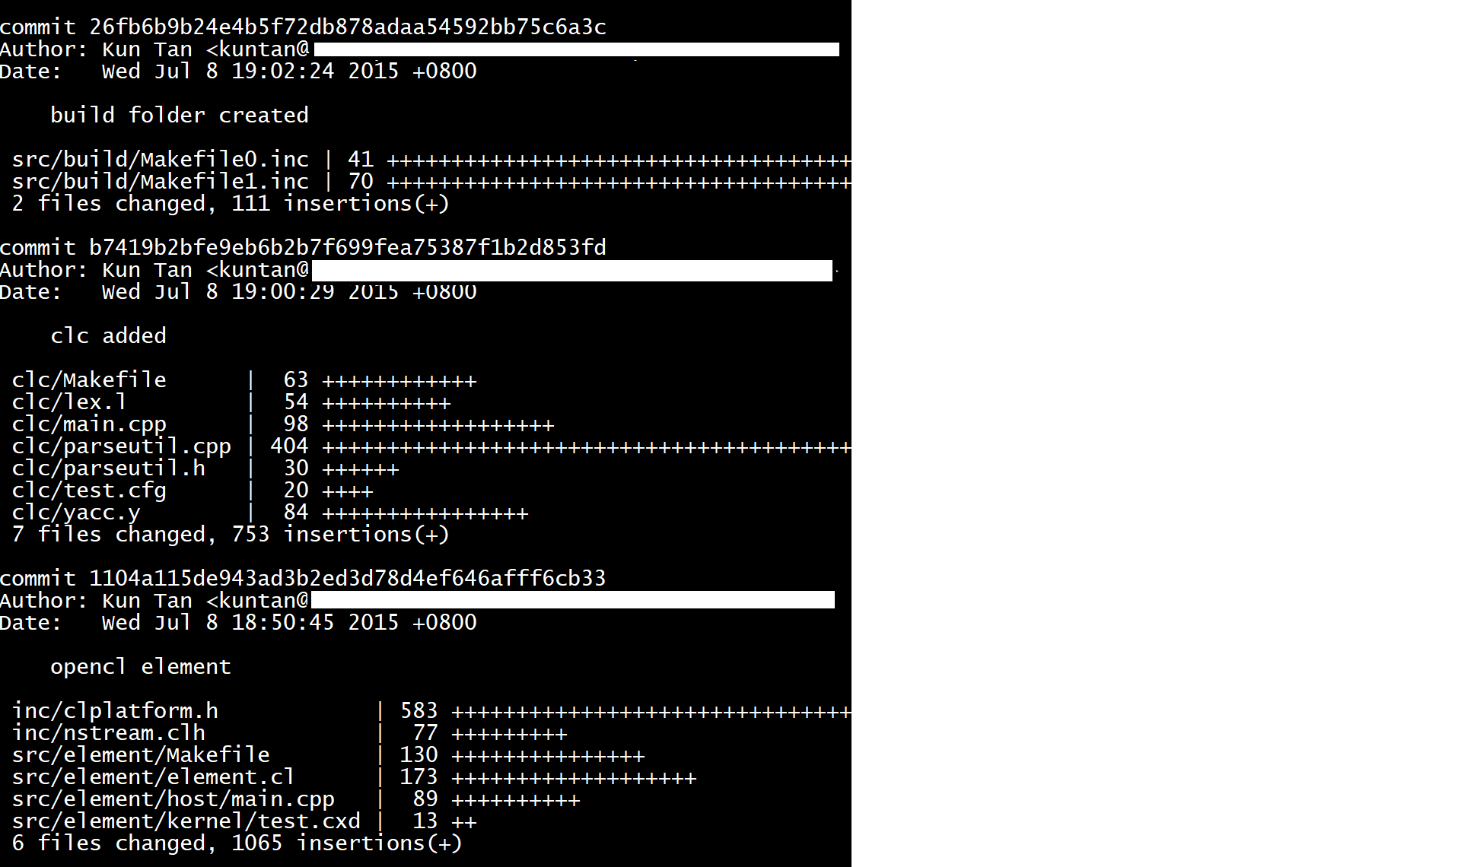
Prototype and microbenchmarks
May 2015 – July:
Dr. Kun Tan wrote the first version of ClickNP compiler
Notes:
The idea of ClickNP was proposed by Kun. He wrote the first version of ClickNP compiler and the first a few sample elements.

Slide 29
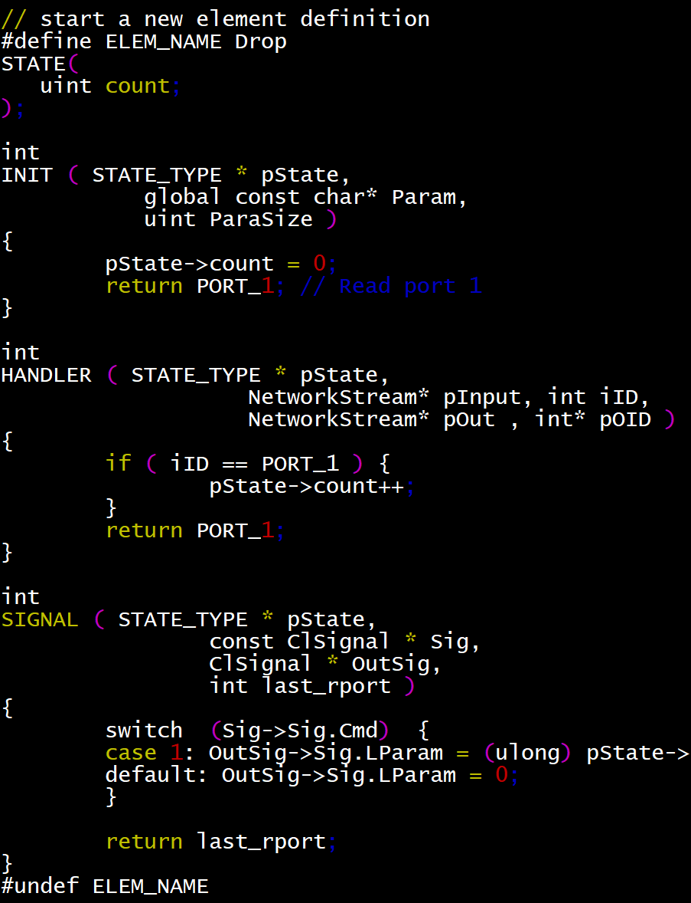
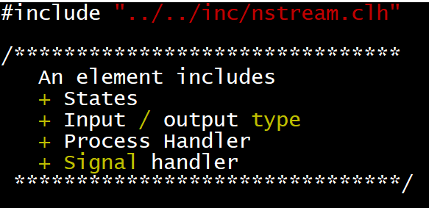
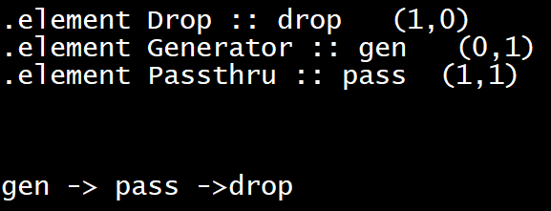
Prototype and microbenchmarks
May 2015 – July:
Dr. Kun Tan wrote the first version of ClickNP compiler
Initial ClickNP language design
Notes:
He proposed the initial ClickNP language design.
Each element includes states, input and output ports, process handler and signal handler.
The elements are written in pure C language.
Elements are connected via Click script.

Slide 30
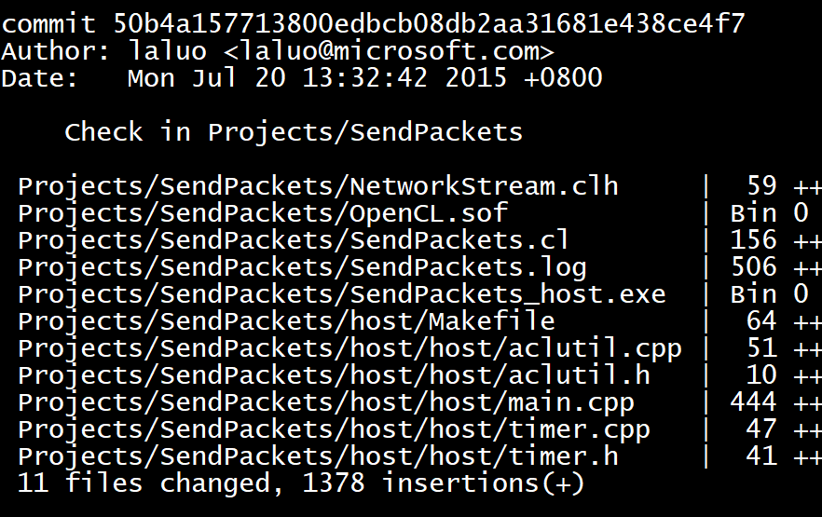
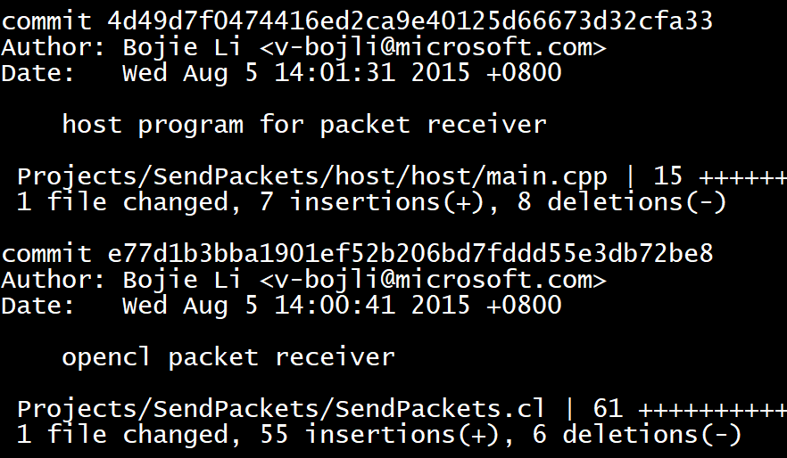
Prototype and microbenchmarks
Dr. Larry Luo in our team developed the first network application, packet generator.
It is in OpenCL language (ClickNP compiles elements to OpenCL).
Then I joined MSRA WNG as an intern, and took over the ClickNP project.
Kun instructed me to write a packet receiver based on the packet generator code.
Notes:
Dr. Larry Luo in our team developed the first network application, packet generator.
It is in OpenCL language (ClickNP compiles elements to OpenCL).
Then I joined MSRA WNG as an intern, and took over the ClickNP project.
Kun instructed me to write a packet receiver based on the packet generator code.

Slide 31
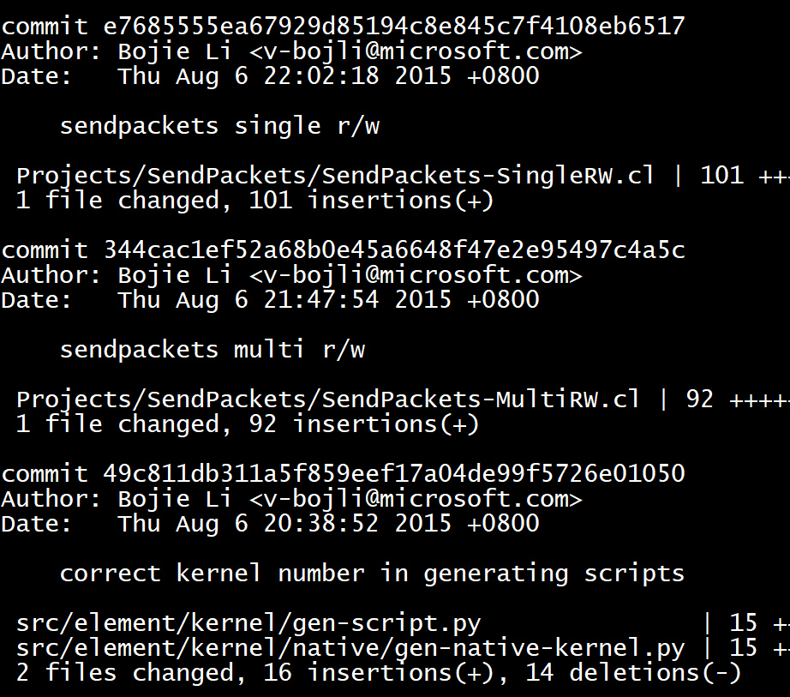
Prototype and microbenchmarks
When I tried to add receiver functionality into OpenCL kernels, unexpected performance degrade occurred…
I wrote 20+ microbenchmarks in one month to understand the behavior of OpenCL compiler.
Notes:
The OpenCL compiler is a third-party product and we do not have its source code.
So we need to test the compiler as a black box and try to understand its internal workings.

Slide 32
Implementation challenges
Loop-carried dependency: Compiler may not infer efficient hardware for many coding styles
Notes:
Through the microbenchmarks, we found three major implementation challenges for using OpenCL to do network processing.
First is loop-carried dependency inside a kernel. The compiler may not be able to infer efficient hardware for many coding styles.

Slide 33
Implementation challenges
Loop-carried dependency: Compiler may not infer efficient hardware for many coding styles
CPU-to-FPGA communication: OpenCL batch I/O and shared on-board mem inefficient for stream processing
Notes:
Second is CPU-to-FPGA communication. In the OpenCL programming model, the packets are first copied to the on-board DRAM in large batches, then dispatched to kernels for execution.
This model introduces high latency due to batching, and limits the packet processing throughput to on-board DRAM throughput.

Slide 34
Implementation challenges
Loop-carried dependency: Compiler may not infer efficient hardware for many coding styles
CPU-to-FPGA communication: OpenCL batch I/O and shared on-board mem inefficient for stream processing
Tough debugging: Recompile takes hours; generated Verilog hard to debug
Notes:
Third is tough debugging on FPGA. Recompiling an OpenCL program takes hours, and the generated Verilog code are hard to debug on the fly.

Slide 35
Implementation challenges
Loop-carried dependency: Compiler may not infer efficient hardware for many coding styles
CPU-to-FPGA communication: OpenCL batch I/O and shared on-board mem inefficient for stream processing
Tough debugging: Recompile takes hours; generated Verilog hard to debug
Will we still use existing high-level synthesis tools to compile OpenCL to Verilog?
Can we build a tool from scratch to compile ClickNP directly into Verilog?
ClickNP
OpenCL
Verilog
FPGA logic
Notes:
These challenges led us to rethink our approach of using OpenCL as an intermediate language between ClickNP and Verilog.
Will we still use existing high-level synthesis tools to compile OpenCL to Verilog?
Can we build a tool from scratch to compile ClickNP directly into Verilog?

Slide 36
Converge system design
Balance explore and exploit
A research project would be endless if we keep exploring
Converge when ideas go wild or deadline approaches
Converge to a solution implementable in reasonable time
Notes:
With so many wild ideas in mind, the ClickNP project seems to be endless.
It was October and the SIGCOMM deadline is in four months.
At that time, Kun told me one word, “converge”.
We need to balance explore and exploit and converge to a feasible solution in reasonable time.

Slide 37
Converge system design
Balance explore and exploit
A research project would be endless if we keep exploring
Converge when ideas go wild or deadline approaches
Converge to a solution implementable in reasonable time
Struggle with existing tools
Do not reinvent the wheel
Distinguish efforts with research value and pure engineering
Find coding styles suitable for existing tools and enforce them
Notes:
We decided to struggle with existing high-level synthesis tools, and not reinvent the wheel.
Developing a high-level synthesis tool by ourselves is too time consuming.
Furthermore, it is more engineering effort, but without much research value.
So we decided to keep using existing tools.
Actually these tools can indeed generate efficient hardware for some simple coding styles.
So our job is to find these coding styles and enforce them manually or automatically.

Slide 38
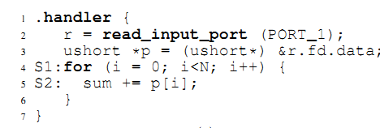
Converge system design
Balance explore and exploit
A research project would be endless if we keep exploring
Converge when ideas go wild or deadline approaches
Converge to a solution implementable in reasonable time
Struggle with existing tools
Do not reinvent the wheel
Distinguish efforts with research value and pure engineering
Find coding styles suitable for existing tools and enforce them
Acceleration comes from specialization
End-to-end principle: Keep real-world applications in mind
Notes:
One may argue that enforcing these coding styles may sacrifice programmability.
For example, ClickNP discourages nested loops.
However, we are not building a language for all FPGA acceleration workloads.
What we are building is a network processing platform.
In network processing, most inner loops can be unrolled with reasonable area cost, and the remaining ones can be flattened by the developer.

Slide 39
Converge system design
Balance explore and exploit
A research project would be endless if we keep exploring
Converge when ideas go wild or deadline approaches
Converge to a solution implementable in reasonable time
Struggle with existing tools
Do not reinvent the wheel
Distinguish efforts with research value and pure engineering
Find coding styles suitable for existing tools and enforce them
Acceleration comes from specialization
End-to-end principle: Keep real-world applications in mind
Notes:
Here comes another principle: Acceleration comes from specialization.
We should always follow the end-to-end principle and keep real-world applications in mind.

Slide 40
Converge system design
Balance explore and exploit
A research project would be endless if we keep exploring
Converge when ideas go wild or deadline approaches
Converge to a solution implementable in reasonable time
Struggle with existing tools
Do not reinvent the wheel
Distinguish efforts with research value and pure engineering
Find coding styles suitable for existing tools and enforce them
Acceleration comes from specialization
End-to-end principle: Keep real-world applications in mind
Make performance predictable to users
Notes:
Finally, when we specialize a system, we should make the performance predictable to users, that is to not hide too much details from the user.
Most problems of the OpenCL to Verilog compiler we use is that it hided too many optimizations in a black box, and we spent a lot of time to understand how it works, and how to write code in its preferred coding style.

Slide 41
ClickNP element library
Element | Fmax (MHz) | Peak Throughput | Delay (cycles) | Resource LE % | Resource BRAM %
L4_Parser | 221.9 | 113.6 Gbps | 11 | 0.8% | 0.2%
IPChecksum | 226.8 | 116.1 Gbps | 18 | 2.3% | 1.3%
NVGRE_Encap | 221.8 | 113.6 Gbps | 9 | 1.5% | 0.6%
AES_CTR | 217.0 | 27.8 Gbps | 70 | 4.0% | 23.1%
SHA1 | 220.8 | 113.0 Gbps | 105 | 7.9% | 6.6%
CuckooHash | 209.7 | 209.7 Mpps | 38 | 2.0% | 65.5%
HashTCAM | 207.4 | 207.4 Mpps | 48 | 18.7% | 22.0%
LPM_Tree | 221.8 | 221.8 Mpps | 181 | 4.3% | 13.2%
SRPrioQueue | 214.5 | 214.5 Mpps | 41 | 2.6% | 0.6%
RateLimiter | 141.5 | 141.5 Mpps | 14 | 16.9% | 14.1%
Throughput: 200 Mpps / 100 Gbps
Mean delay: 0.19 us, max delay: 0.8 us
Mean LoC: 80, max LoC: 196
Nearly 100 elements
20% re-factored from Click modular router
Cover packet parsing, checksum, tunnel
encap/decap, crypto, hash tables, prefix matching, packet scheduling, rate limiting…
Notes:
In the ClickNP paper, we built an element library with nearly 100 elements.
About 20% of them are re-factored from Click modular router, and the remaining ones cover lots of network functions.

Slide 42
Sample network functions
  Each NF takes about one week to develop
Network Function | Lines of Code * | Number of Elements | Resource LE % | Resource BRAM %
Pkt generator | 13 | 6 | 16% | 12%
Pkt capture | 12 | 11 | 8% | 5%
OpenFlow firewall | 23 | 7 | 32% | 54%
IPSec gateway | 37 | 10 | 35% | 74%
L4 load balancer | 42 | 13 | 36% | 38%
pFabric scheduler | 23 | 7 | 11% | 15%
* ClickNP configuration file
Notes:
Using the elements, we have built several sample network functions.
Each network function only needs tens of lines of code for the ClickNP configuration file.
Each network function only takes about one week to develop, if all the elements are ready.

Slide 43
Build a solid system
But the real story was not one week per NF
Network Function | Development Date | #Elements reused | Developer
Pkt generator | May – Oct | 0 / 6 | Larry Luo, Yanqing Peng
Pkt capture | Aug – Oct | 2 / 11 | Renqian Luo
OpenFlow firewall | Aug – Nov | 2 / 7 | Renqian Luo
NVGRE tunneling | Aug – Oct | 3 / 10 | Yanqing Peng
IPSec gateway | Sep – Nov | 5 / 10 | Yanqing Peng
L4 load balancer | Oct – Jan | 7 / 13 | Bojie Li
pFabric scheduler | Dec – Jan | 4 / 7 | Bojie Li
Elements were designed and implemented while NFs are developed.
The elements can be reused by other NFs.
Notes:
But the real story was not one week per network function.
Because we do not have network functions in the first place, we need to design and implement elements while developing network functions.

Slide 44
Build a solid system
But the real story was not one week per NF
Network Function | Development Date | #Elements reused | Developer
Pkt generator | May – Oct | 0 / 6 | Larry Luo, Yanqing Peng
Pkt capture | Aug – Oct | 2 / 11 | Renqian Luo
OpenFlow firewall | Aug – Nov | 2 / 7 | Renqian Luo
NVGRE tunneling | Aug – Oct | 3 / 10 | Yanqing Peng
IPSec gateway | Sep – Nov | 5 / 10 | Yanqing Peng
L4 load balancer | Oct – Jan | 7 / 13 | Bojie Li
pFabric scheduler | Dec – Jan | 4 / 7 | Bojie Li
Elements were designed and implemented while NFs are developed.
The elements can be reused by other NFs.
Notes:
However, the elements can be reused by future network functions.
As we see in the table, the portion of reused elements increase as the project proceeds.

Slide 45
Build a solid system
But the real story was not one week per NF
Network Function | Development Date | #Elements reused | Developer
Pkt generator | May – Oct | 0 / 6 | Larry Luo, Yanqing Peng
Pkt capture | Aug – Oct | 2 / 11 | Renqian Luo
OpenFlow firewall | Aug – Nov | 2 / 7 | Renqian Luo
NVGRE tunneling | Aug – Oct | 3 / 10 | Yanqing Peng
IPSec gateway | Sep – Nov | 5 / 10 | Yanqing Peng
L4 load balancer | Oct – Jan | 7 / 13 | Bojie Li
pFabric scheduler | Dec – Jan | 4 / 7 | Bojie Li
Elements were designed and implemented while NFs are developed.
The elements can be reused by other NFs.
Notes:
Although the network functions become larger and larger, the development takes less and less time.
This is partly due to more and more elements can be reused, partly due to the development of the ClickNP toolchain.
As we mentioned before, we met several implementation challenges, this is the main reason why the first several network functions take so many months to develop.

Slide 46
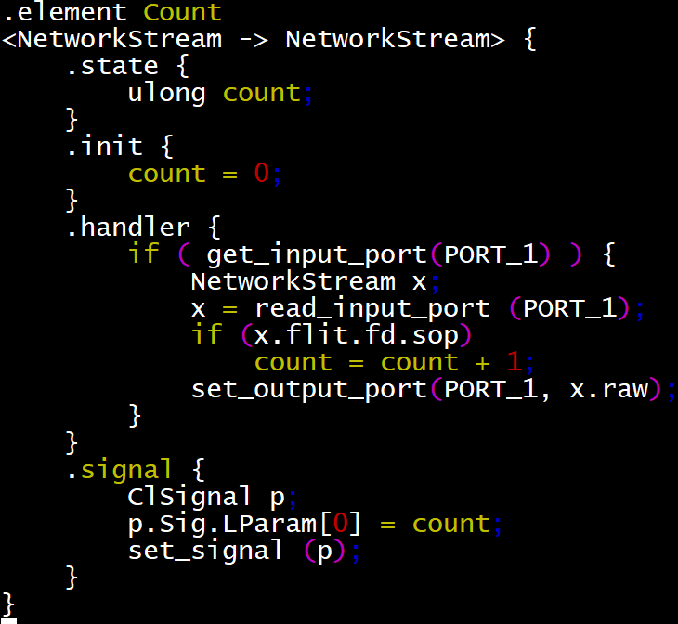
Build a solid system
Co-evolution of toolchain and application
Loop-carried dependency: Element definition language to enforce coding styles and automatically perform optimizations
Notes:
The process of building the system is a co-evolution of the ClickNP toolchain and our network function applications.
For the loop-carried dependency in the OpenCL compiler, we designed a language to define ClickNP elements, instead of using the OpenCL language directly.
The language enforces the coding styles preferred by the OpenCL compiler, and our ClickNP compiler automatically performs several optimizations.

Slide 47
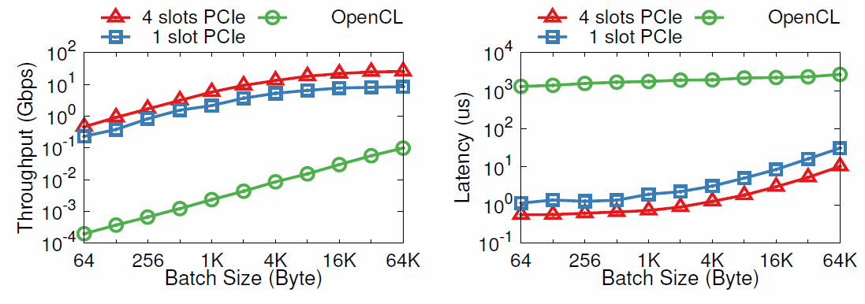
Build a solid system
Co-evolution of toolchain and application
Loop-carried dependency: Element definition language to enforce coding styles and automatically perform optimizations
CPU-to-FPGA communication: High-throughput and low latency communication channel between CPU and FPGA
Notes:
Second, to improve CPU-to-FPGA communication, we leveraged OpenCL channels to build a high-throughput and low latency channel between CPU and FPGA.
As we can see in the figures, the throughput improves by one thousand times and the latency reduces by one thousand times.

Slide 48
Build a solid system
Co-evolution of toolchain and application
Loop-carried dependency: Element definition language to enforce coding styles and automatically perform optimizations
CPU-to-FPGA communication: High-throughput and low latency communication channel between CPU and FPGA
Tough debugging: Host element; write once, run on both FPGA and CPU; familiar debugging tools
Notes:
The third challenge is tough debugging.
Although debugging on FPGA is time consuming, ClickNP elements are written in a high level language.
So we design host elements to enable elements to be written once and run on both FPGA and CPU. Then we can use familiar debugging tools on CPU to debug the elements.

Slide 49
Compare with state-of-the-art
When FPGA is better than CPU? Why?
100x performance speedup is not convincing enough by the numbers themselves.
The key point is where the speedup comes from, and what the reviewers can learn from our design.
Notes:
As a final step before submission of the paper, we need to compare our system throughput with state-of-the-art design.
One question my mentor Kun always ask me is: When FPGA is better than CPU, and why it is better.

Slide 50
Compare with state-of-the-art
When FPGA is better than CPU? Why?
100x performance speedup is not convincing enough by the numbers themselves.
The key point is where the speedup comes from, and what the reviewers can learn from our design.
Reductionist perspective
Why is it faster? How each component contributes?
Holistic perspective
Evaluate with real-world applications (end-to-end principle)
Be fair with existing work. We even optimized Click + DPDK for comparison, because our competitor is pure CPU packet processing instead of a specific system.
Notes:
In evaluation, we typically take two perspectives: a reductionist perspective to evaluate each component of the system, and a holistic perspective to evaluate the system as a whole with real-world applications.
When comparing with existing work, one important thing to keep in mind is to be fair.
We even optimized the existing work of Click plus DPDK, because we want to compare FPGA with CPU packet processing in general, instead of a specific system.

Slide 51
Development after Submission
Network → general stream processing
FPGA development platform for research and engineering projects in our team
Applications:
Memory Efficient Loss Recovery for Hardware-based Transport in Datacenter (Yuanwei Lu, APNET’17)
HTTPS (RSA) (Guo Chen and Tianyi Cui)
Deep Neural Network inference (Qiang Lou)
Regex Matching (Guo Chen)
Multi-path RDMA (Yuanwei Lu)
In-memory Key-value Store (Zhenyuan Ruan)
Container Networking and Synchronization (Zibo Wang)
Total-Order Multicast (Gefei Zuo)
Extending ClickNP framework:
Distributed ClickNP (Guo Chen)
Go for FPGA (Tianyi Cui and Jason Cong)
Notes:
After the paper submission, the ClickNP project does not end.
ClickNP moves from network processing to general stream processing, and enables multiple research and engineering projects in our team, including applications. For example, Yuanwei’s paper on Memory Efficient Loss Recovery, which he will present this afternoon.
And extending the ClickNP framework to distribute to a cluster of FPGAs, and use Go language to support concurrency more naturally.

Slide 52
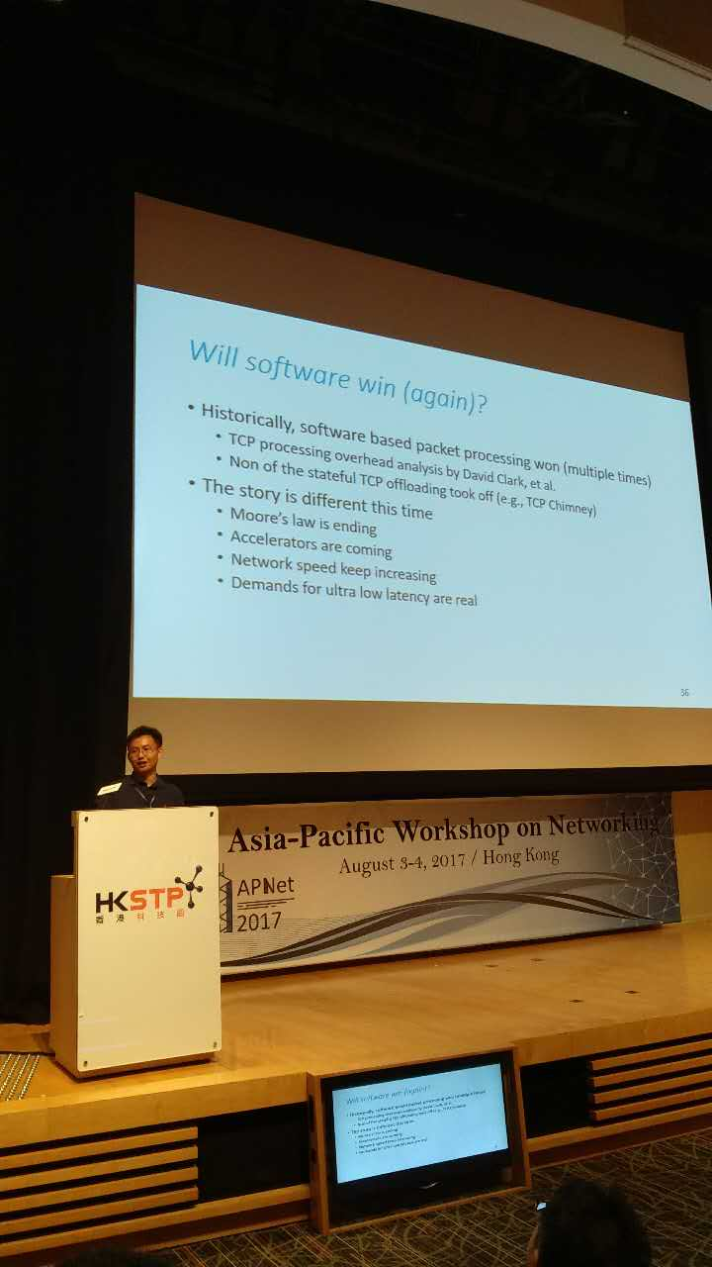
Accelerators are coming
Notes:
In the end of my talk, I would like to do an advertisement of my research field, accelerating data centers with reconfigurable hardware.
In Chuanxiong’s keynote this morning, he tells us that Moore’s law is ending and accelerators are coming.

Slide 53
Accelerators still follow Moore’s law
Note: assumes power consumption of 160W/TPU2 chip (not confirmed)
LOG SCALE
Moore’s Law
(2x per 1.5 years)
Notes:
As we can see in the figure, the X axis is estimated year of development, and the Y axis is energy efficiency in giga operations per second per watt.
The Moore’s law of general-purpose processors is ending, but the Moore’s law of specialized hardware is not ending.
The orange line shows GPU, the red line shows FPGA and the green line shows TPU, the deep learning ASIC from Google. These specialized hardware still follow the predictions of Moore’s law.

Slide 54
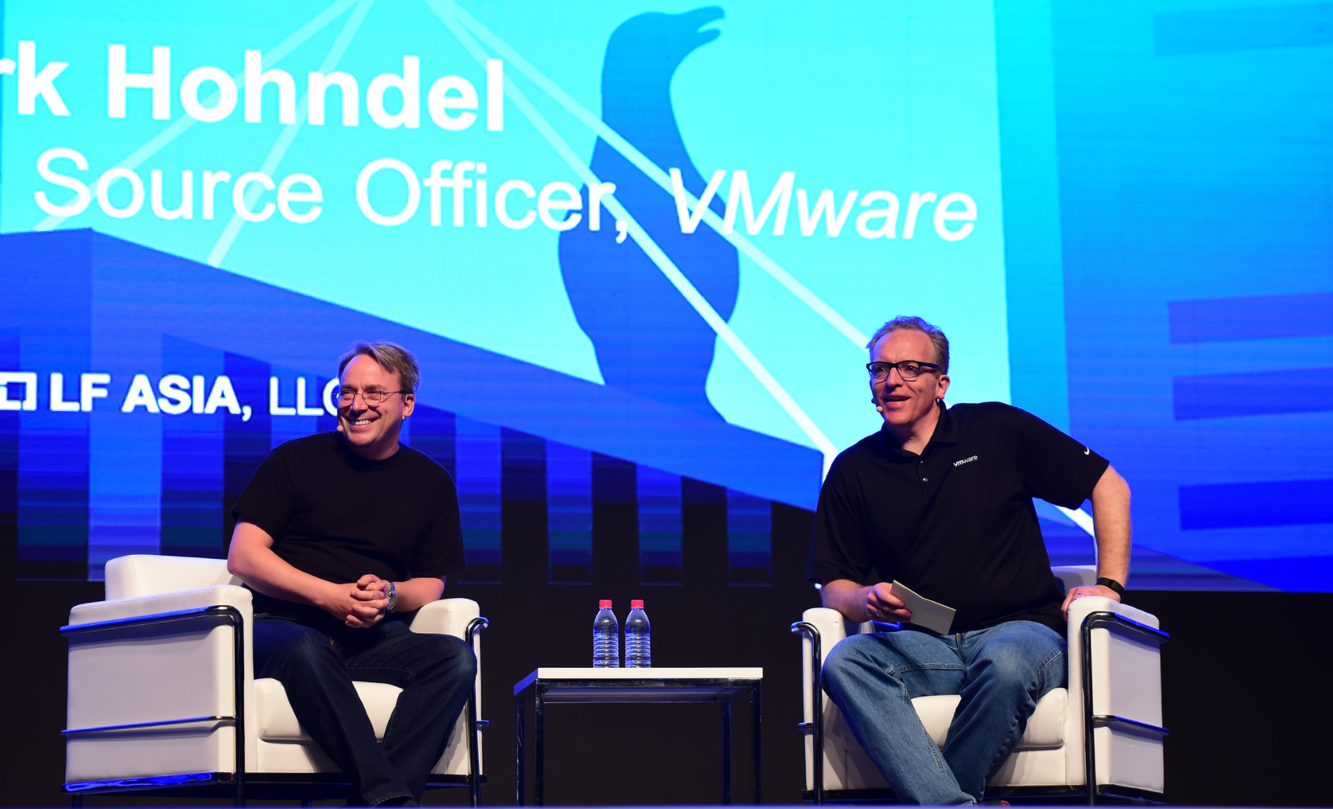
Linus Torvalds advocating FPGA
Dirk (VMWare VP): If you are starting today, what would you do?
Linus Torvalds: When I created Linux, the programming of hardware was much more easier than when I was a child…
I would consider FPGA if you are interested in chip design, because the price of FPGAs is more affordable these years, and there have been a lot of free tools to program them...
Source: LC3 Conference, Beijing, June 2017
Notes:
FPGA is gaining more and more popularity in the industry.
For example in the LC3 conference one month ago, Linus Torvalds, the creator of Linux and Git, says that I would consider FPGA because the price of FPGAs is more affordable these years, and there have been a lot of free tools to program them.

Slide 55


Vision: Reconfigurable Cloud
Interconnected FPGAs form a separate plane of computation
Add programmability to the data path within and across servers
Program FPGAs efficiently for computation, communication and control
DRAM
DRAM
Hardware acceleration plane
CPU
CPU
Deep neural networks
QPI
SQL
Web search ranking
SDN offload
Gen3 x8
Gen3 2x8
Web search ranking
NIC
DRAM
1
FPGA
2
Traditional software (CPU) server plane
QSFP
QSFP
QSFP
40Gb/s
40Gb/s
ToR
Notes:
Finally I would like to end this talk with a vision of Microsoft, that FPGAs form a separate plane of computation in data centers, to make the cloud fully reconfigurable.

Slide 56
Thank you!
Questions!
Notes:
Thank you for listening!

