Slide 1
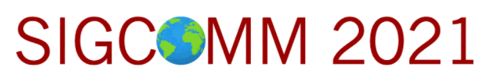

1Pipe: Scalable Total Order Communication in Data Center Networks
Bojie Li
Huawei Technologies
Gefei Zuo
University of Michigan
Wei Bai
Microsoft Research
Lintao Zhang
BaseBit Technologies
Notes:
I’m Bojie Li from Huawei. It’s my honor to speak at SIGCOMM ‘21 about 1Pipe, scalable total order communication in data center networks.

Slide 2
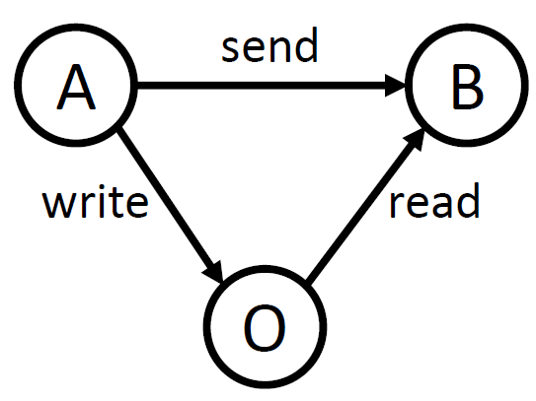
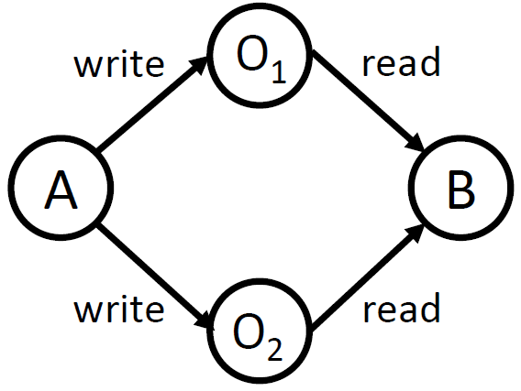
Ordering Hazards in Distributed Systems
Causal Order
Total Order & Atomicity
A write to O
A send to B
B read from O
A write metadata to O₁,
A write data to O₂
B read metadata from O₁,
B read data from O₂
Requirements:
Isolation
Failure atomicity
Notes:
Ordering is fundamental in distributed systems.
There are two kinds of ordering anomalies in a distributed system. The first kind violates causal ordering. For example, Host 𝐴 writes data to another host 𝑂, then sends a notification to host 𝐵. When 𝐵 receives the notification, it issues a read to 𝑂, but may not get the data due to the delay of A’s write operation.
The second kind violates total ordering or atomicity. Host 𝐴 writes to both data 𝑂2 and metadata 𝑂1. Concurrently, host 𝐵 reads from both data 𝑂2 and metadata 𝑂1, but they may be inconsistent. We require a group of operations to be atomic in the case of concurrent transactions and failures.

Slide 3
1Pipe Abstraction
S₁
R₁
S₂
R₂
S₁→R₁
S₁→R₂
S₂→R₂
S₂→R₁
…
…
S_{n}
R_{n}
“One big pipe”:
Messages are sent in groups (called scatterings) and serialized in a virtual pipe.
Different receivers deliver messages in a consistent order, as if the scatterings are pulled out from the pipe and delivered to the receivers sequentially.
Notes:
To avoid these two kinds of ordering anomalies, we propose a “one big pipe” abstraction.
…(text)

Slide 4
1Pipe Abstraction
Formally: Causally and Totally Ordered Communication Support (CATOCS)
Total order: Messages are delivered in the same order to all receivers.
Causal order: Messages are delivered in Lamport logical clock sense.
Atomicity: Either all or none messages in a scattering are delivered.
Total Order & Atomicity
Causal Order
Notes:
Formally, 1Pipe provides causally and totally ordered communication support which implies total order, causal order and atomicity.

Slide 5
1Pipe Abstraction: Restricted Atomicity
Full failure atomicity is impossible! [FLP theorem]
Approach of existing fault tolerant systems: Replication!
Paxos tolerates f failures with 2f+1 replicas.
Deliver M
Receiver 1
Sender 1
Deliver M
Receiver 2
If Receiver 1 can fail permanently at any time, how can Receiver 2 know whether it has delivered M or not?
Replicating every message has too much overhead.
So, 1Pipe offers restricted failure atomicity with a mechanism to invoke the application on failures.
onepipe_reliable_send(vec[dst, msg])
TS, src, msg = onepipe_reliable_recv()
onepipe_proc_fail_callback(func(proc, TS))
Design principle: optimize for the normal case because data center is mostly reliable.
Notes:
We must make it clear that 1Pipe only provides restricted failure atomicity. Because the seminal FLP theorem already said full failure atomicity is impossible.
Replicating every message would introduce a too high overhead. Fortunately, we can apply the design principle of optimizing for the normal case, because data center is mostly reliable. We have a mechanism to invoke the application to handle the failures.

Slide 6
How to achieve total order?
Notes:
Now we consider the core design of 1Pipe: how to achieve total order.

Slide 7
Strawman 1: Centralized Sequencer (Eris, SOSP’17)
Receiver A
A1
B1
C1
A2
B2
Sender 1
ABC
Programmable Switch (Sequencer)
Receiver B
A1
B1
C1
B3
C2
Sender 2
AB
DROP
Counter: A2 B3 C2
Sender 3
BC
Receiver C
A1
B1
C1
B3
C2
Notes:
The first strawman is the approach of Eris. Eris uses a programmable switch as a centralized sequencer, which keeps a counter for each receiver. When a receiver detects a gap in its sequence number, as shown in the red circles, the receiver knows there is a lost message, the failure coordinator will use a traditional consensus algorithm to achieve consensus among replicas. However, the major problem is that the switch becomes a centralized bottleneck.

Slide 8
Strawman 2: Physical Timestamp Aggregation
Last timestamp from each sender
Received
Delivered
10:00
Receiver A
11:00
11:00
A
10:00 ABC
9:00
AB
9:00
BC
Sender 1
10:00 ABC
9:00
10:00
Receiver B
Sender 2
11:00
A
9:00
AB
9:00
10:00 ABC
9:00
AB
9:00
BC
9:00
Sender 3
9:00
BC
Receiver C
10:00
0:00
10:00 ABC
9:00
AB
9:00
Scalability drawbacks:
Each message needs to broadcast to all receivers (including those not needed).
Periodic beacons needed for an idle pair of receivers (quadratic number of beacons, not scalable).
Cannot detect packet loss and failures.
Notes:
Now we come to the second strawman. We synchronize physical time on senders. The messages are attached with physical timestamps. When a receiver receives a message, it first puts the message into receive buffer. The receiver maintains a timestamp for each sender, and computes the minimum timestamp of all senders. If the minimum timestamp is greater or equal than the timestamp of some message, then the receiver can safely deliver this message.
This approach also has scalability drawbacks.

Slide 9
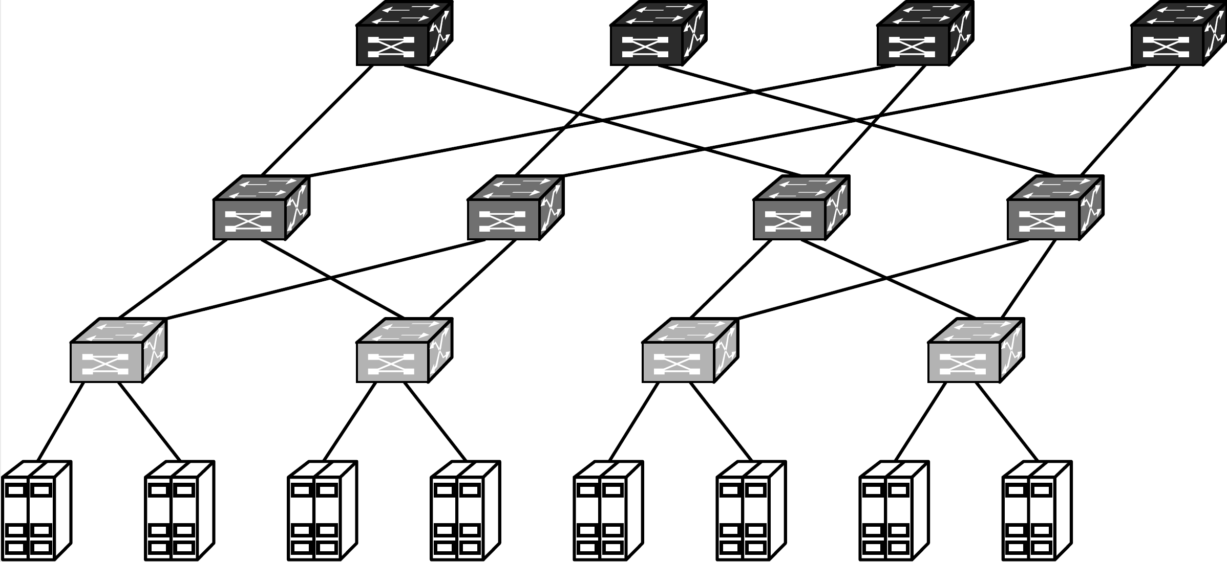
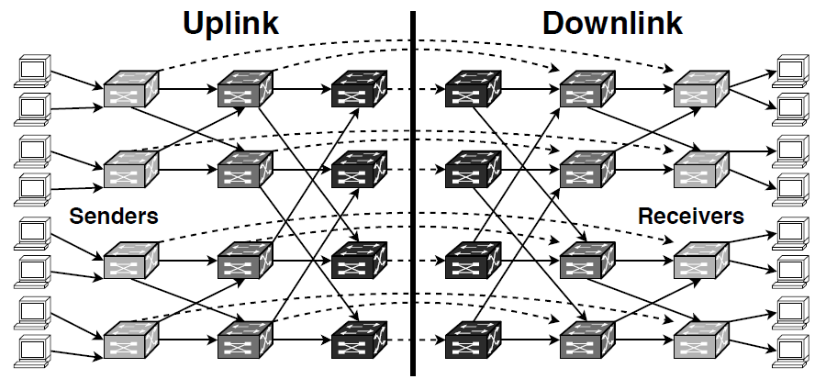
Data Center Topology
Multi-rooted Tree
Routing DAG (Directed Acyclic Graph)
Notes:
Now we design 1Pipe for the data centers. A typical data center has multi-rooted tree topology. Each host has two roles, both sender and receiver. The routing graph between sender and receiver is a directed acyclic graph. In this directed acyclic graph, each switch and host is separated into two parts, and the dashed arrows indicate a loopback on the network switch.

Slide 10
1Pipe: Deliver Minimum Timestamp Barrier
Received
Delivered
Sender 1
Msg 10:00 Barrier 10:00 A
Receiver A
Msg 10:00 Barrier 9:00
A
Programmable Switch
Sender 2
Msg 11:00
Barrier 11:00
B
Receiver B
Msg 11:00
Barrier 9:00
B
Min Barrier 9:00
Sender 3
Msg 9:00
Barrier 9:00
C
Receiver C
Msg 9:00
Barrier 9:00
C
Each message has two timestamps: message and barrier timestamp.
When a switch or a host receives a packet with barrier timestamp B from a network link L, it indicates that the message timestamp and barrier timestamp of future arrival packets from link L will be larger than B.
Notes:
The key design of 1Pipe is similar to the last strawman, which synchronizes the physical clocks on senders, aggregates the minimum timestamp on receivers, and delivers the messages in increasing timestamp order on receivers. In the last strawman, each sender needs to send beacon to each receiver. To solve this scalability problem, we use a programmable switch to aggregate the minimum timestamp of senders, and broadcast the minimum timestamp to all receivers. Each packet has two timestamps, a message timestamp and a barrier timestamp. The message timestamp does not change during forwarding, but the barrier timestamp is changed during forwarding. When a switch or a host receives a packet with some barrier timestamp from a network link, it indicates that the message timestamp and barrier timestamp of all future arrival packets from this link will be larger than the barrier timestamp.

Slide 11
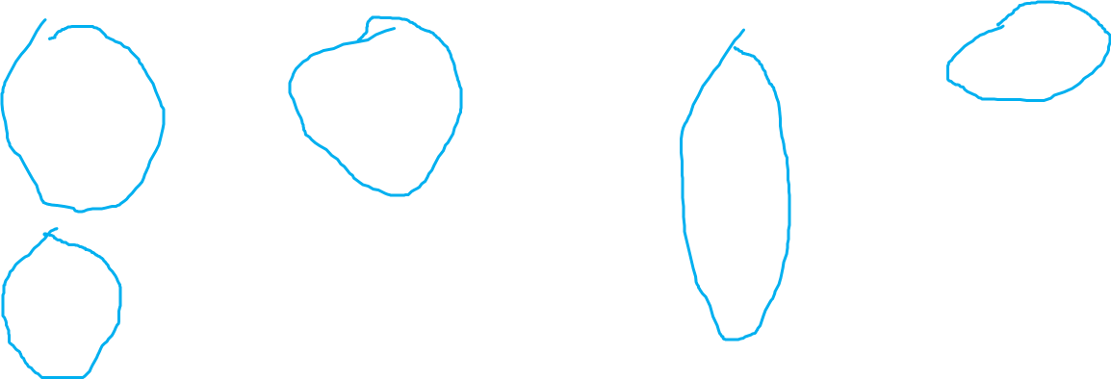
1Pipe: Hierarchical Barrier Aggregation
Sender 1
Barrier 10:00
Switch 1a
Switch 1b
Barrier 7:00
Receiver 1
Barrier 9:00
Min
9:00
Min
7:00
Sender 2
Barrier 9:00
Barrier 9:00
Barrier 7:00
Receiver 2
Sender 3
Barrier 8:00
Barrier 7:00
Barrier 7:00
Receiver 3
Switch 2a
Switch 2b
Min
7:00
Barrier 7:00
Min
7:00
Sender 4
Barrier 7:00
Barrier 7:00
Receiver 4
Barrier timestamps are aggregated hierarchically through layers of switches hop-by-hop, and finally the receiver gets the barrier of all reachable hosts and links in the network.
Beacons are sent periodically on each idle link to its one-hop neighbors.
Notes:
Now let’s consider a routing graph of network switches. We can hierarchically aggregate the barrier timestamps through layers of switches hop-by-hop. For example, the switch 1a computes the minimum barrier of sender 1 and 2, and broadcasts the minimum barrier to switch 1b and switch 2b. Switch 1b and 2b also receives the minimum barrier from sender 3 and 4. So switch 1b and 2b gets the barrier of all 4 senders. In this way, each receiver gets the barrier of all reachable hosts and links in the network. We recall the barrier property that on each network link, the barrier timestamp is the minimum possible future data timestamp on this link. So, a receiver can deliver message in receive buffer when it receives a barrier timestamp higher or equal to the message timestamp.
Finally, if some network links are idle, it will stall the entire network. So, beacons are sent periodically on each idle link to its one-hop neighbors. Okay, this is how 1Pipe achieves scalability.

Slide 12
How to Handle Packet Loss
Received
Delivered
Sender 1
Msg 10:00 Barrier 10:00 A
Receiver A
Msg 10:00 Barrier 10:00
A
Programmable Switch
Min Barrier 10:00
Sender 2
Msg 11:00
Barrier 11:00
B
Msg 8:00
Barrier 8:00
A
Receiver B
Msg 11:00
Barrier 10:00
B
Incorrect: Receiver A should deliver TS 8:00 from Sender 2 before delivering TS 10:00 from Sender 1, but the switch and receiver A do not know TS 8:00 has lost.
Unlike centralized sequencer, the receivers do not know whether or not a message is lost.
Adding hop-to-hop sequence number to detect packet loss is not capable for many switches.
Notes:
Now let’s consider packet losses. Unlike centralized sequencer, because the timestamps are not consecutive, the receivers do not know whether or not a message is lost.
A straightforward solution is to add hop-to-hop sequence number to detect packet loss. However, this is not capable for many commodity switches.

Slide 13
Best-effort and Reliable 1Pipe
Best-effort
Reliable
onepipe_unreliable_send(vec[dst, msg])
TS, src, msg = onepipe_unreliable_recv()
onepipe_send_fail_callback(func(TS, dst, msg))
onepipe_reliable_send(vec[dst, msg])
TS, src, msg = onepipe_reliable_recv()
onepipe_proc_fail_callback(func(proc, TS))
Some use cases of 1Pipe only need ordering but do not need reliability.
For example, a read-only transaction can be safely retried if some of the messages are lost.
Best effort 1Pipe provides at-most-once delivery, and notifies application when a packet is lost (detected by timeout).
Reliable 1Pipe recovers lost packets and provides exactly once delivery at the cost of an extra RTT.
Reliable 1Pipe delivers all or none messages in a scattering when no switches or host fail permanently (i.e., if it recovers, it can deliver consistently).
Reliable 1Pipe allows the application to customize failure handling.
Notes:
As we will see next, our solution to recover lost packets and failures require an extra round-trip time. So we provide two kinds of services: a best effort service that provides ordering but not reliability. For example, a read-only transaction can be safely retried if some of the messages are lost. The reliable service provides exactly once delivery at the cost of an extra round-trip time.

Slide 14
Reliable 1Pipe: Two-Phase Commit
Sender
Switch
Receiver 1
Receiver 2
Prepare 9:00
ACK 9:00
Commit 9:00
To achieve reliability, 1Pipe adds one round-trip of prepare phase.
Prepare and ACK messages do not need ordered delivery.
When a sender collects all ACKs below or equal to timestamp T, it sends a commit message to the neighbor switch with timestamp T.
The switches aggregate min timestamp of commit messages as in best-effort 1Pipe.
A receiver delivers messages below or equal to commit timestamp.
Notes:
Reliable 1Pipe achieves reliability with a two-phase commit approach. The sender first sends a prepare message to the receiver with a message timestamp. The receiver puts the message into the receive buffer, and responds with an ACK message.
When a sender collects all ACKs below or equal to timestamp T, it sends a commit message to the neighbor switch. The switches aggregates minimum timestamp of commit messages.
When a receiver receives a commit timestamp, it delivers buffered messages below or equal to the commit timestamp.

Slide 15
Reliable 1Pipe: Packet Loss Handling
Sender
Switch
Receiver 1
Receiver 2
Prepare 9:00
End-to-end loss detection via timeout or duplicate ACK
ACK 9:00
ACK 9:00
Retransmitted Prepare 9:00
Beacon or next commit message
ACK 9:00
Commit 9:00
Commit 10:00
Lost Prepare and ACK messages are retransmitted end-to-end.
Lost Commit messages are retransmitted hop-by-hop (notice the monotonicity of commit timestamp).
Notes:
Reliable 1Pipe retransmits lost prepare and ACK messages end-to-end, while lost commit messages are retransmitted hop-by-hop.

Slide 16
Failure Recovery of Hosts and Switches
Detect failure via beacon timeout, and report to controller.
Controller determines failed process P and failure timestamp T based on the routing graph.
Controller broadcasts failure notification.
Each process discards messages sent from P or to P with timestamp before T.
For each discarded message, to achieve atomicity, the sender recalls other messages in the same scattering from the receiver.
Each process executes user-defined callback function (e.g., traditional consensus to sync replicas).
Controller removes failed process and resumes normal operation.
②Determine
Controller
③Broadcast
④Discard
①Detect
Host
⑥Callback
⑤Recall
⑦Resume
④Discard
Data Plane Switch
Host
⑥Callback
①Detect
(beacon timeout)
Host
Notes:
1Pipe relies on a highly available controller to coordinate failure recovery of hosts and switches. Please refer to the paper for more details.

Slide 17
How to implement 1Pipe on hosts and switches?
Notes:
Next, we come to the implementation of 1Pipe.

Slide 18
1Pipe Implementation on Hosts
Host
Application 3
Application 2
lib1pipe
Application 1
lib1pipe
lib1pipe
1Pipe API
Reliable Sending
Packet Reordering
Time Synchronizer
Send Buffer
Receive Buffer
Flow and Congestion Control
Beacon Generator
RDMA UD
Standard RDMA NIC
Notes:
We implement 1Pipe using RDMA Unreliable Datagram. This is because if we use RDMA reliable connection, each QP will buffer several messages, and we cannot ensure the ordering among these messages on the network link. The transport is implemented in software.

Slide 19
1Pipe Implementation on Switches
Programmable Switch
Timestamp 100
Barrier 100
Timestamp 300
Barrier 100
Payload A
Payload B
Egress link
Egress link
Programmable Switch
Switch Barrier 100
Link Barrier 100
Link Barrier 200
Ingress link
Ingress link
Timestamp 100
Barrier 100
Timestamp 300
Barrier 200
Payload A
Payload B
Delay = base_delay + beacon_interval + clock_skew
Notes:
For implementation on network switches, we consider three types of network switches with different programmability. Using a programmable switch, the switch data plane can aggregate barrier timestamps in the header of each packet.

Slide 20
1Pipe Implementation on Switches
Programmable Switch
Switch CPU
Timestamp 100
Barrier 100
Timestamp 300
Barrier 100
Timestamp 200
Payload A
Payload A
Payload B
Beacon barrier 100
Egress link
Egress link
Egress link
Commodity Switch
Programmable Switch
Packet Forwarding ASIC
Switch CPU
Switch Barrier 100
Switch Barrier 100
Link Barrier 100
Link Barrier 200
Link Barrier 200
Ingress link
Ingress link
Ingress link
Timestamp 100
Barrier 100
Timestamp 300
Barrier 200
Timestamp 200
Payload A
Payload A
Payload B
Beacon barrier 200
Delay = base_delay + beacon_interval + clock_skew
Delay = base_delay + switch_processing_delay * number_of_hops + beacon_interval + clock_skew
Notes:
For a commodity switch without a programmable switching chip, we implement in-network processing on the switch CPU. Although it cannot process packets in data plane, they have a CPU to process control-plane packets. Compared to a typical server, the switch CPU is typically less powerful and has lower bandwidth. Because the switch CPU cannot process every packet, data packets are forwarded by the switching chip directly.

Slide 21
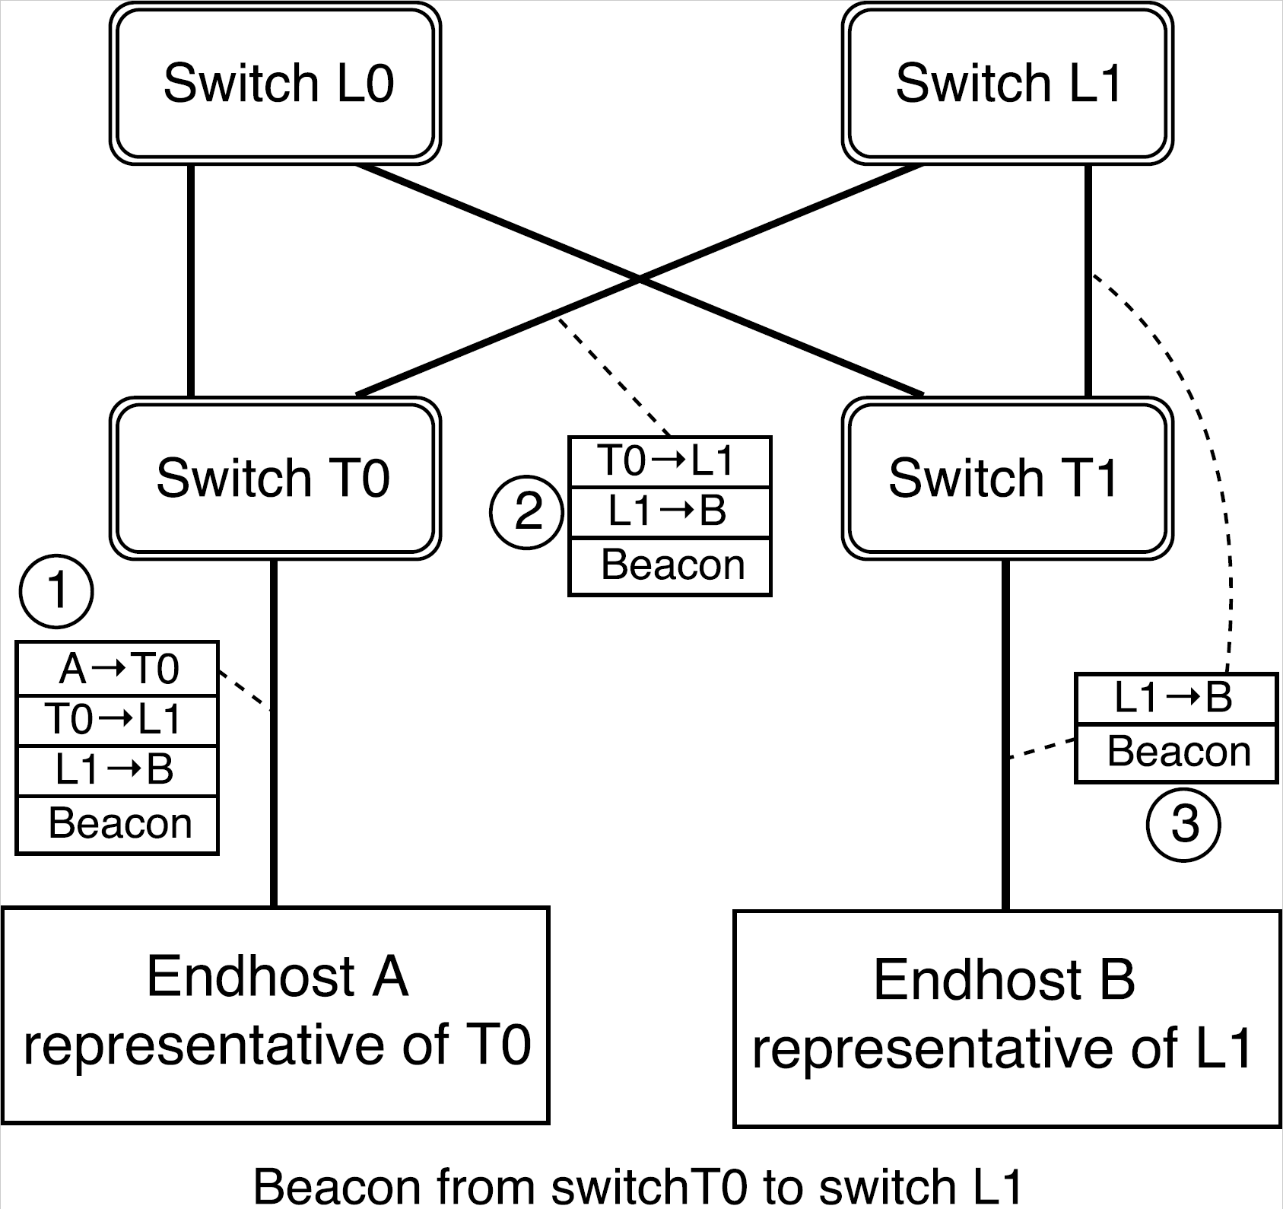
1Pipe Implementation on Switches (cont’d)
Delegate Switch Processing to a Host
Delay = base_delay + number_of_hops * (RTT_between_switch_and_host_representative + host_processing_delay) + beacon_interval + clock_skew
Notes:
If the switch vendor does not expose access interfaces to switch CPUs, we can offload the beacon processing to end hosts. We designate an end-host representative for each network switch.

Slide 22
Evaluation
Notes:
Now, the evaluation.

Slide 23
Testbed Setup
3-layer fat-tree topology with 32 servers and 10 switches
  Each rack has 8 servers
Number of processes: 2, 4, …, 512
  2, 4, 8 processes: each process on a host in a same rack
  16 processes: each process on a host in 2 racks
  32 processes: each process on a host in 4 racks
  64, 128, 256, 512 processes: multiple processes on each host
Traffic pattern: all-to-all, no locality
8 servers
8 servers
8 servers
8 servers
Notes:
We evaluate 1Pipe in a 3-layer fat-tree topology with 32 servers and 10 switches.

Slide 24
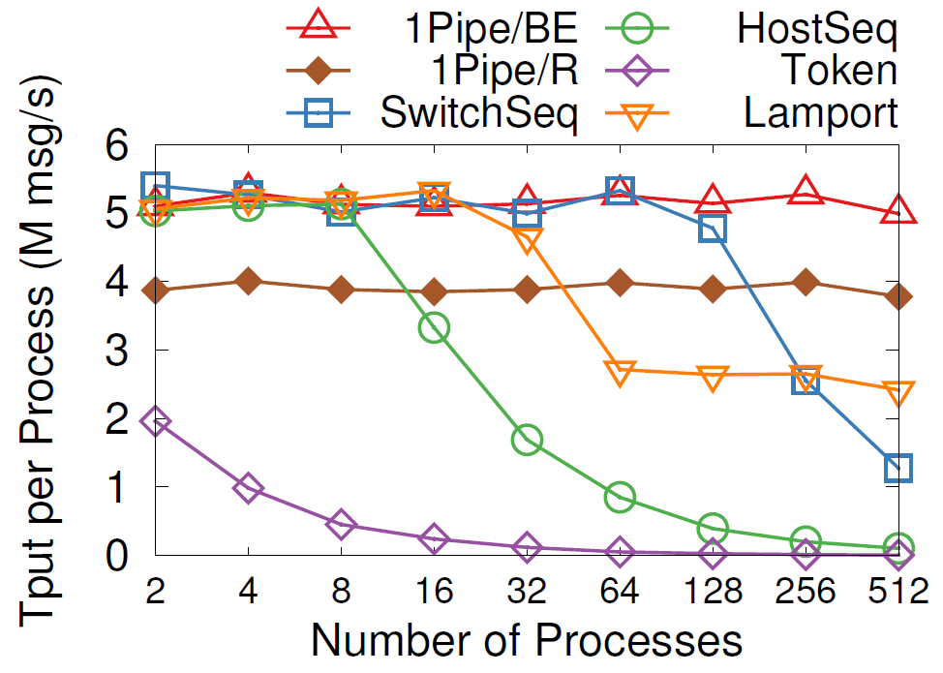
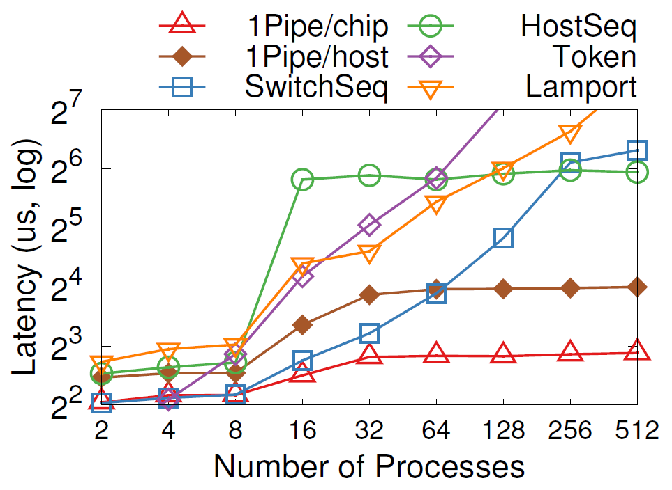
Microbenchmarks
Throughput
Latency
BE: best-effort, R: reliable
Chip: programmable chip, host: host representative
Notes:
Now we compare 1Pipe with other total-order broadcast algorithms. 1Pipe scales linearly to 512 processes, achieving 5M messages per second per process. The throughput of 1Pipe is limited by CPU processing and RDMA messaging rate. Reliable 1Pipe has 25% lower throughput than best effort 1Pipe due to two-phase commit overhead.
In contrast, if we use switch or host as a sequencer, the sequencer is a central bottleneck.
Best effort 1Pipe with programmable chip delivers the lowest latency overhead, which is almost constant with different number of network layers and processes. End host representatives introduce extra forwarding delay from the switch to the end host. Reliable 1Pipe adds an RTT to Best effort 1Pipe.

Slide 25
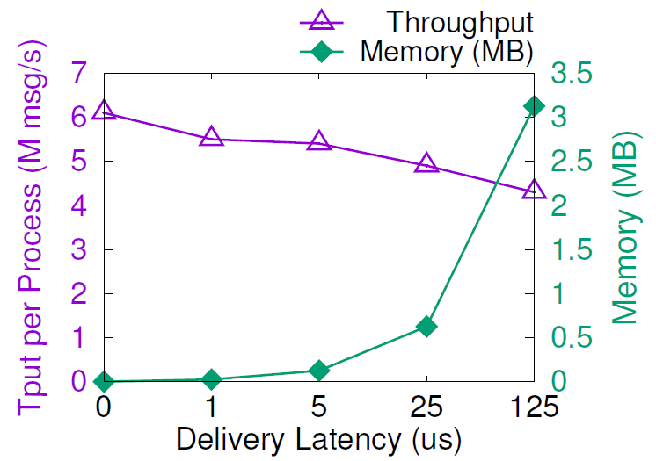
1Pipe Has Low Overhead
Periodic beacons: 3 𝜇s in testbed
  CPU processing overhead: one CPU core per server
  Network bandwidth overhead: 0.3% of 100 Gbps link
  Beacon is hop-by-hop, so, its overhead is fixed for any network scale
Reordering overhead at senders and receivers
  Send and receive buffer: a few megabytes
  Throughput: 4~6 M messages per second per core
Packet header overhead: 24 bytes
Notes:
1Pipe has low overhead.
Processing beacons needs one CPU core per server and only require 3 in a thousand bandwidth.
There is a memory overhead for send and receive buffer, which only takes a few megabytes.
The packet header overhead is 24 bytes per packet.

Slide 26
Case Study: Transactional Key-Value Store
Best effort 1Pipe:
Read(A) Read(B) Read(C)
Read Client
Storage A
Storage servers execute the Read and Write requests delivered by 1Pipe.
Write Client
Storage B
Reliable 1Pipe:
Write(B) Write(C)
Storage C
R/W Client
Reliable 1Pipe:
Read(B) Write(C)
Notes:
Now we see a case study: transactional key-value store.
For read-only transactions, we use best effort 1Pipe because it does not have any side effect. If any of the Read request fails, the client can simply retry the request.
This is why we design best effort 1Pipe.
Transactions including at least write operation needs to use reliable 1Pipe to ensure atomicity.
In normal cases, the transaction is completed in one RTT.

Slide 27
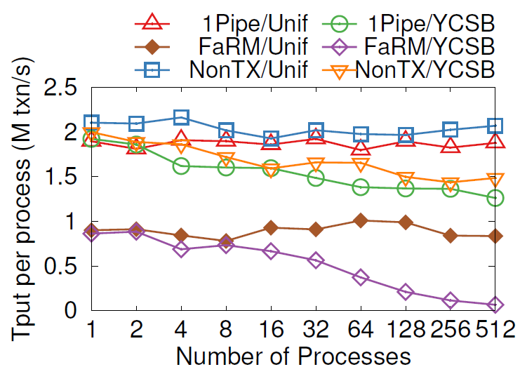
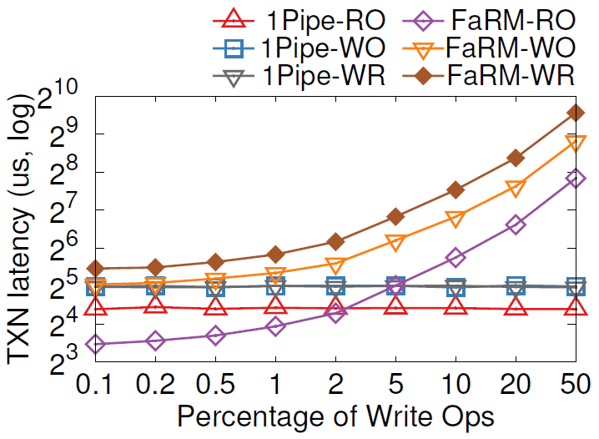
Case Study: Transactional Key-Value Store
Throughput
Latency
RO = Read Only
WO = Write Only
WR = Read + Write
Notes:
In both uniform and YCSB distribution, 1Pipe delivers scalable throughput, which is 90% of a non-transactional
key-value store. As number of processes increase, YCSB scales not as linearly as uniform, because contention on hot keys lead to load imbalance of different servers.
The latency of 1Pipe is almost constant because servers process read and write ops on a same key in order. Write-only and Read-Write transactions use reliable 1Pipe, which is slower than read-only transactions that uses best effort 1Pipe. With high write percentage, FaRM latency skyrockets due to lock contention on hot keys and transaction aborts.

Slide 28
Limitations of 1Pipe
Cannot achieve atomicity of scattering under permanent failures.
  System stalls on failures, and invokes the application to recover failures.
  1Pipe handles normal cases, and application handles corner cases.
Require hosts to synchronize clocks at microsecond accuracy.
  Bad clocks will impact delivery latency but not violate correctness.
  During the research, we explored other ways to synchronize logical timestamps, but did not find enough advantage over physical time.
A straggler host or network link will slow down the entire network.
  A possible approach: partition the network into multiple instances.
The protocol is not resistant to adversarial nodes.
Notes:
Now we look at limitations of 1Pipe.
First, 1Pipe cannot achieve atomicity of scattering under permanent failures.
Second, 1Pipe requires hosts to synchronize clocks at microsecond accuracy. Bad clocks will impact delivery latency but not violate correctness.
Third, a straggler host or network link will slow down the entire network.
Finally, 1Pipe assumes all participants are not adversarial, and we leave the security problems to future work.

Slide 29
Conclusion
1Pipe proposes a causal and total order communication abstraction that delivers groups of messages in sender’s clock time order with restricted failure atomicity.
1Pipe achieves scalability and efficiency by utilizing programmable switches to aggregate ordering information while forwarding data packets as usual.
1Pipe can simplify and accelerate many applications including transactional key-value store, replication, independent transactions, and distributed data structures.
CATOCS is a controversial topic since 1980s. 1Pipe puts new insight into it in the context of data center networks. We expect future work to explore the boundary between network transport and applications.

Slide 30
Thanks

